Slide 1

A Christ-Centered SEL & Leadership Formation Program
Bishop Diego High School • Grades 9-12

Slide 2
JUNIOR • GRADE 11
Relating Through Differences
Explores the 7 Motivational Gifts of the Father framework as a tool for understanding personal communication styles. Grounded in Romans 12:6-8, this session helps students identify their own personality-based gifts (Prophecy, Service, Teaching, Encouragement, Giving, Leadership, and Mercy) and learn to bridge communication gaps with others.
CASEL FOCUS
Social Awareness & Responsible Decision-Making
CST LENS
Solidarity

Slide 3
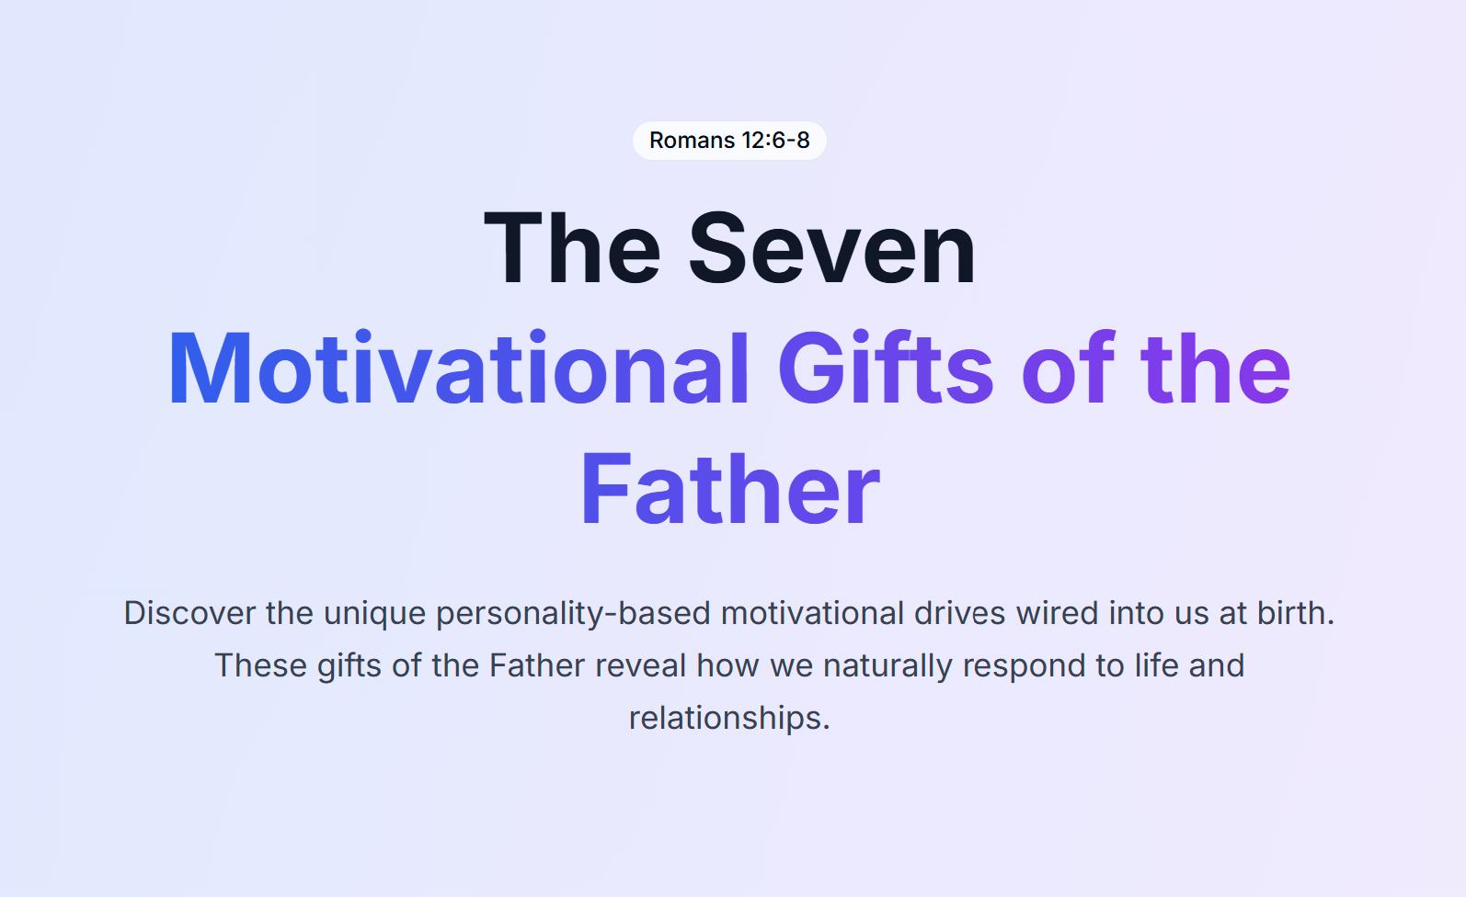


Slide 4
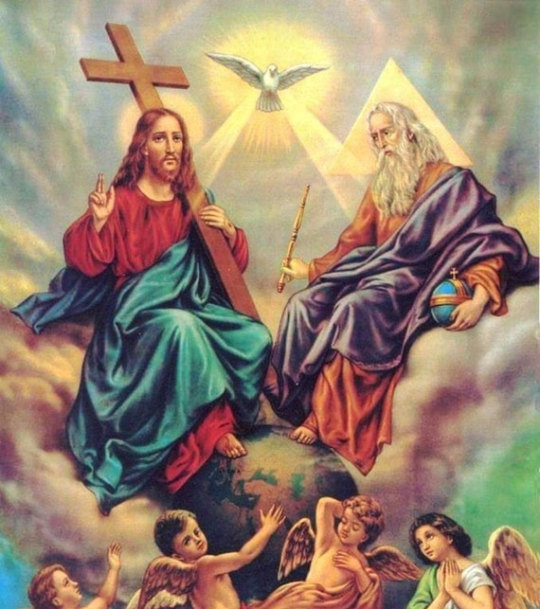
Gifts of the Father, Gifts of the Son, and Gifts of the Holy Spirit

Slide 5
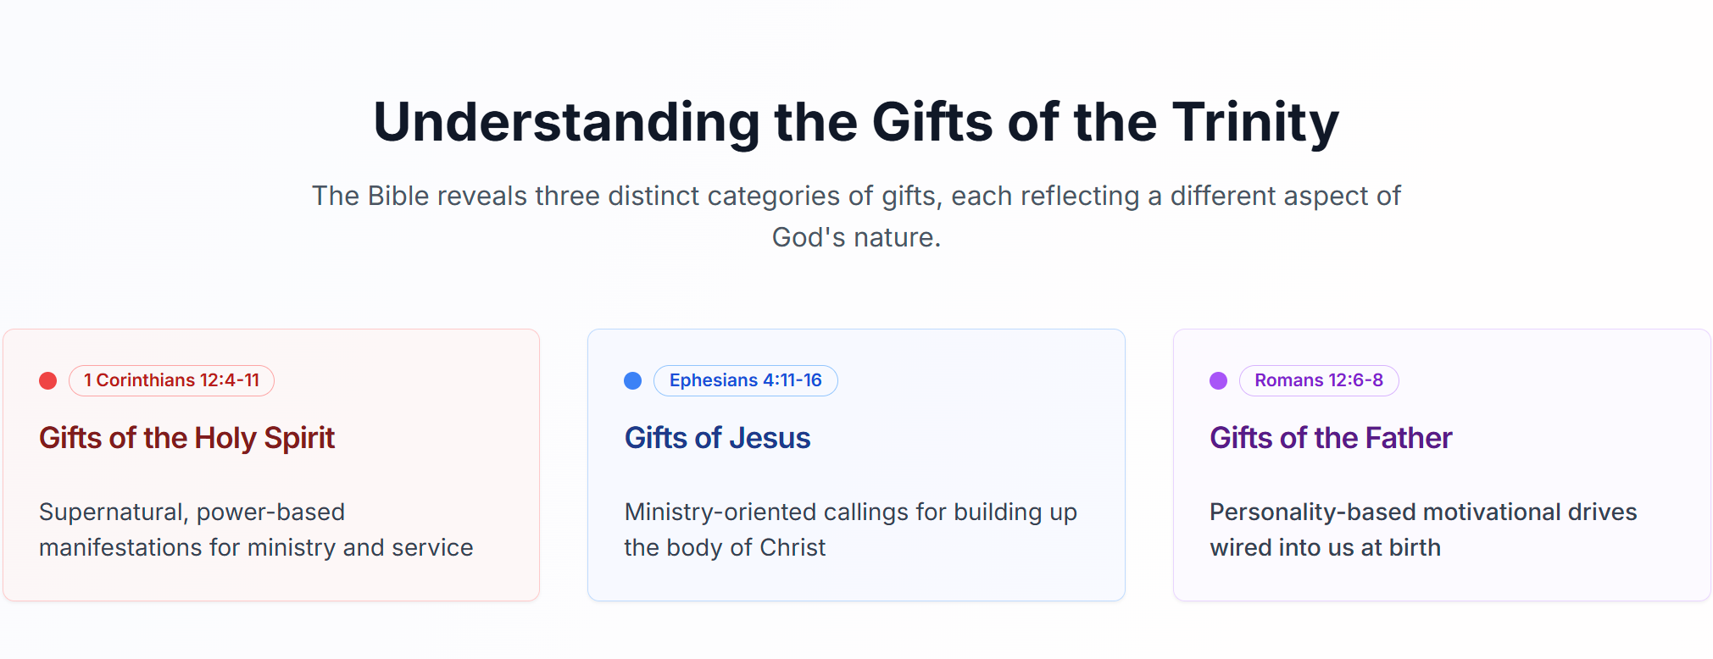

Slide 6
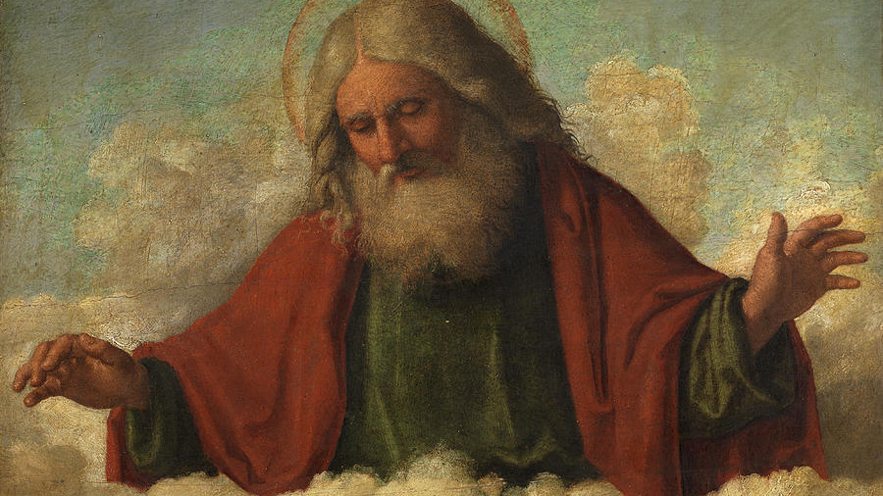
Gifts of Father God – Personality-Based Core Motivational Drives

Slide 7

Romans 12: 3-8 Personality Giftings
3 For by the grace given to me I tell everyone among you not to think of himself more highly than one ought to think, but to think soberly, each according to the measure of faith that God has apportioned. 4 For as in one body we have many parts, and all the parts do not have the same function, 5 so we, though many, are one body in Christ and individually parts of one another.

Slide 8
Romans 12: 3-8 Personality Giftings
⁶ We have different gifts, according to the grace given to each of us. If your gift is prophesying, then prophesy in accordance with your faith; ⁷ if it is serving, then serve; if it is teaching, then teach; ⁸ if it is to encourage, then give encouragement; if it is giving, then give generously; if it is to lead, do it diligently; if it is to show mercy, do it cheerfully.

Slide 9
Personality Selection Activity
Directions: Go to the seven zones and read the descriptive words and stand next to the zone that:
Round 1: Which of the words describes you the best?
Round 2: Which describes you second best?
Round 3: Which one is most different than you?

Slide 10
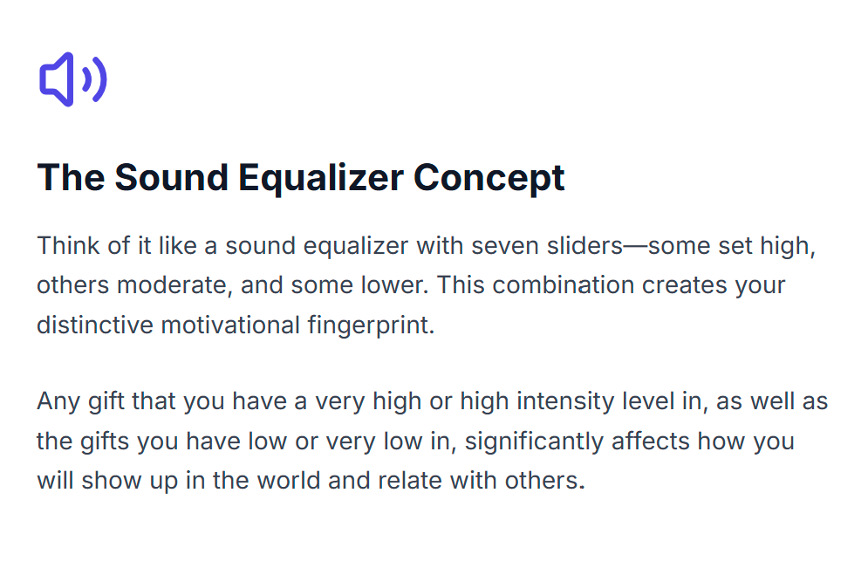

Slide 11
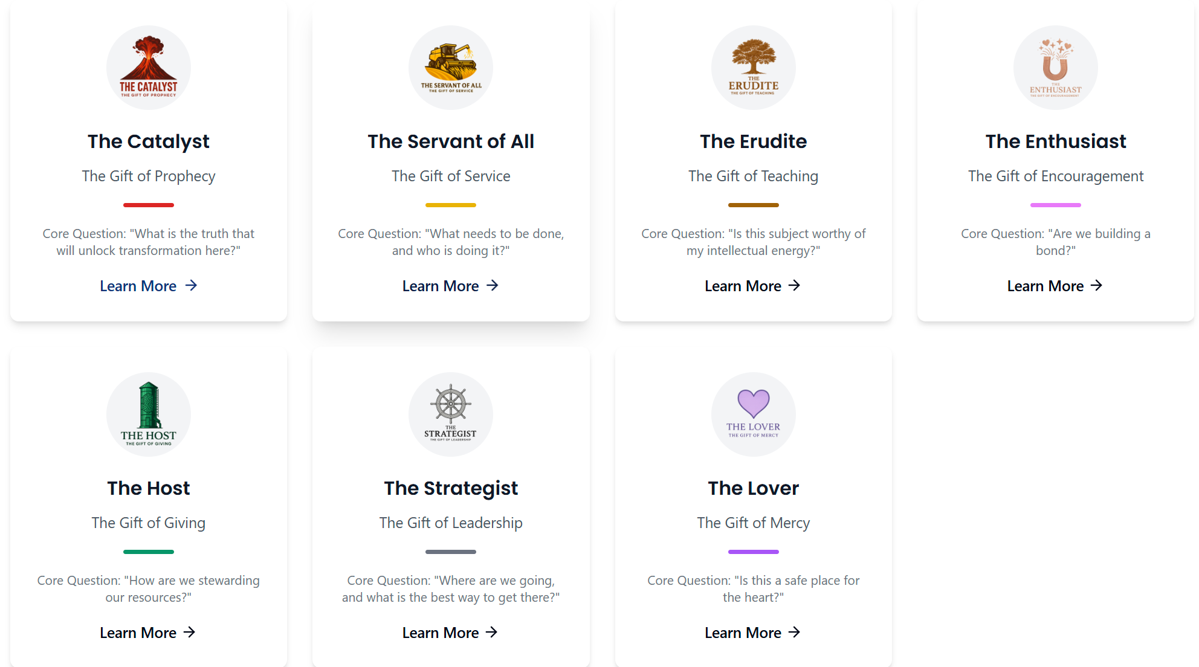

Slide 12
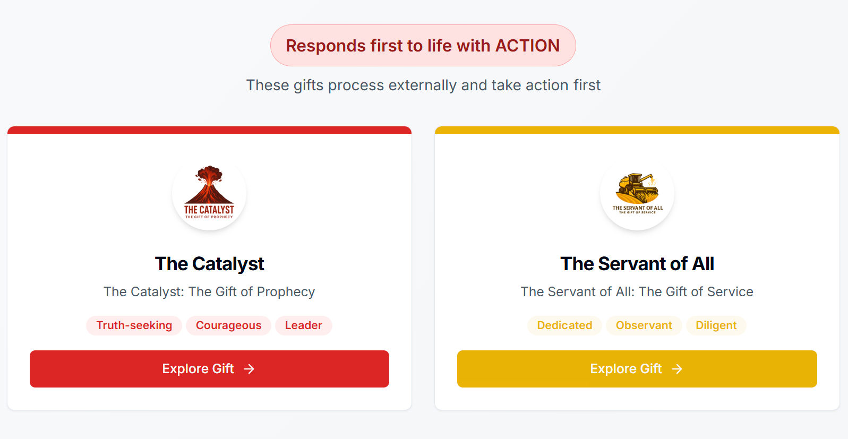
The Do, Think, Feel Framework was adapted from the 7 Life Languages https://www.lifelanguages.com/

Slide 13
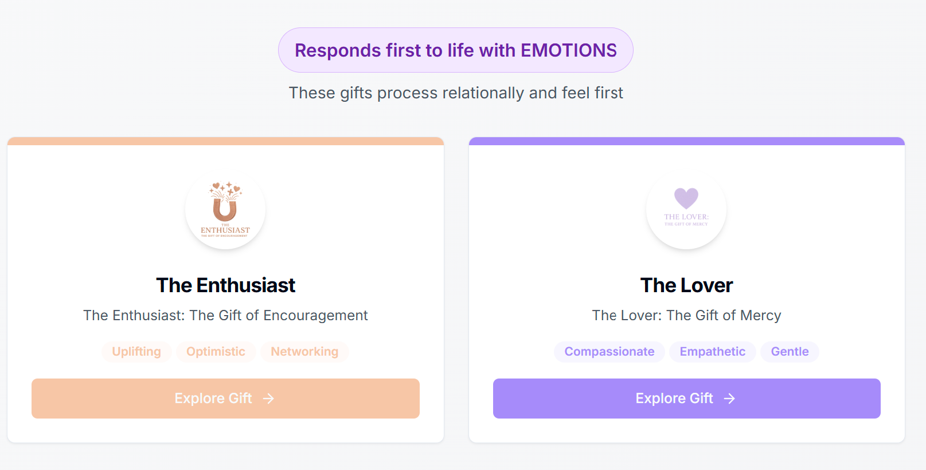
The Do, Think, Feel Framework was adapted from the 7 Life Languages https://www.lifelanguages.com/

Slide 14
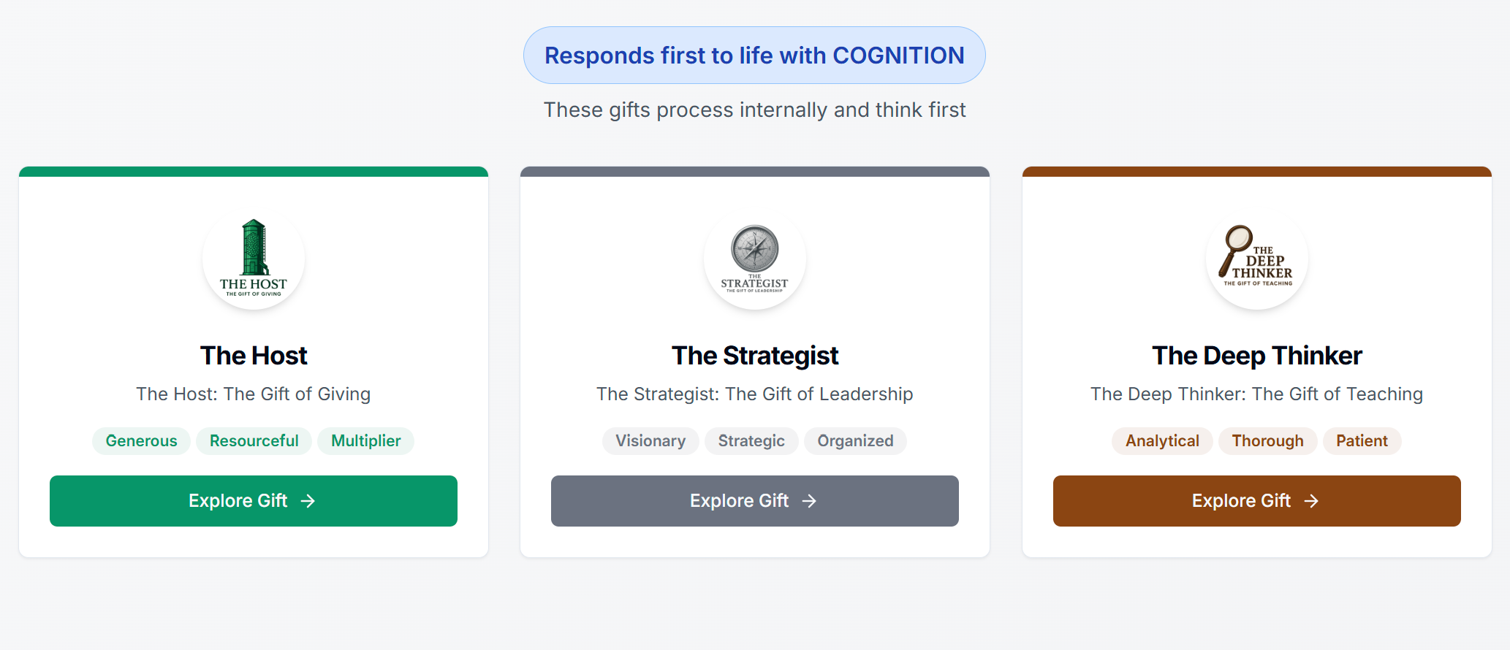

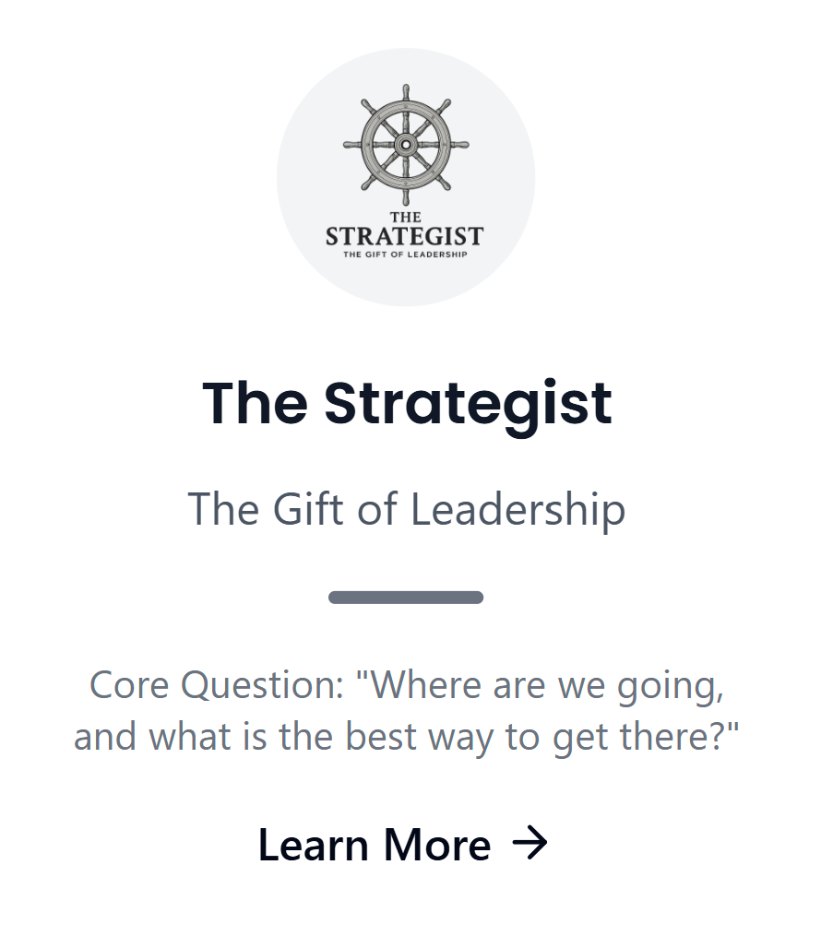

The Do, Think, Feel Framework was adapted from the 7 Life Languages https://www.lifelanguages.com/

Slide 15
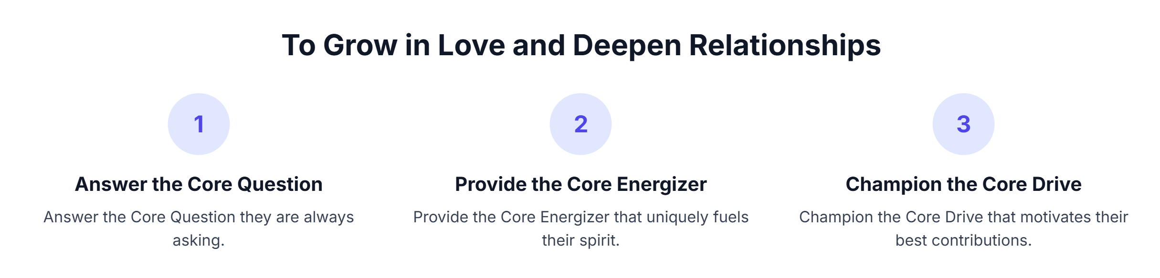

Slide 16
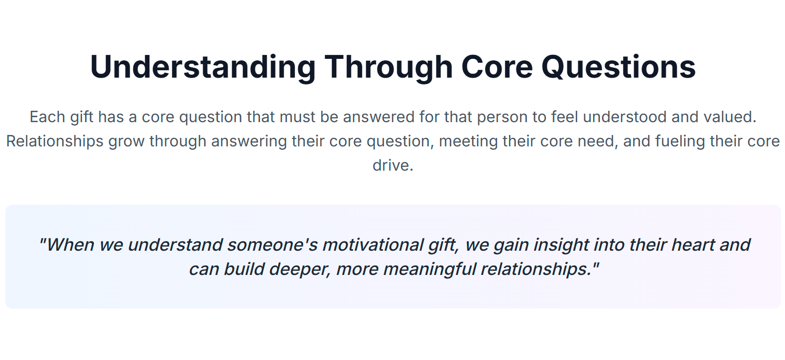

Slide 17
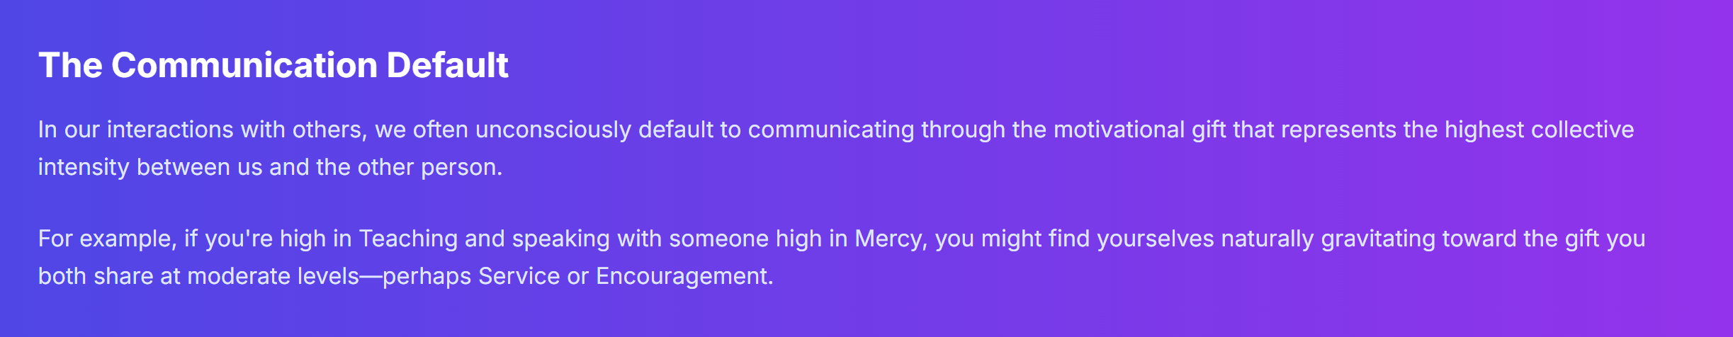

Slide 19
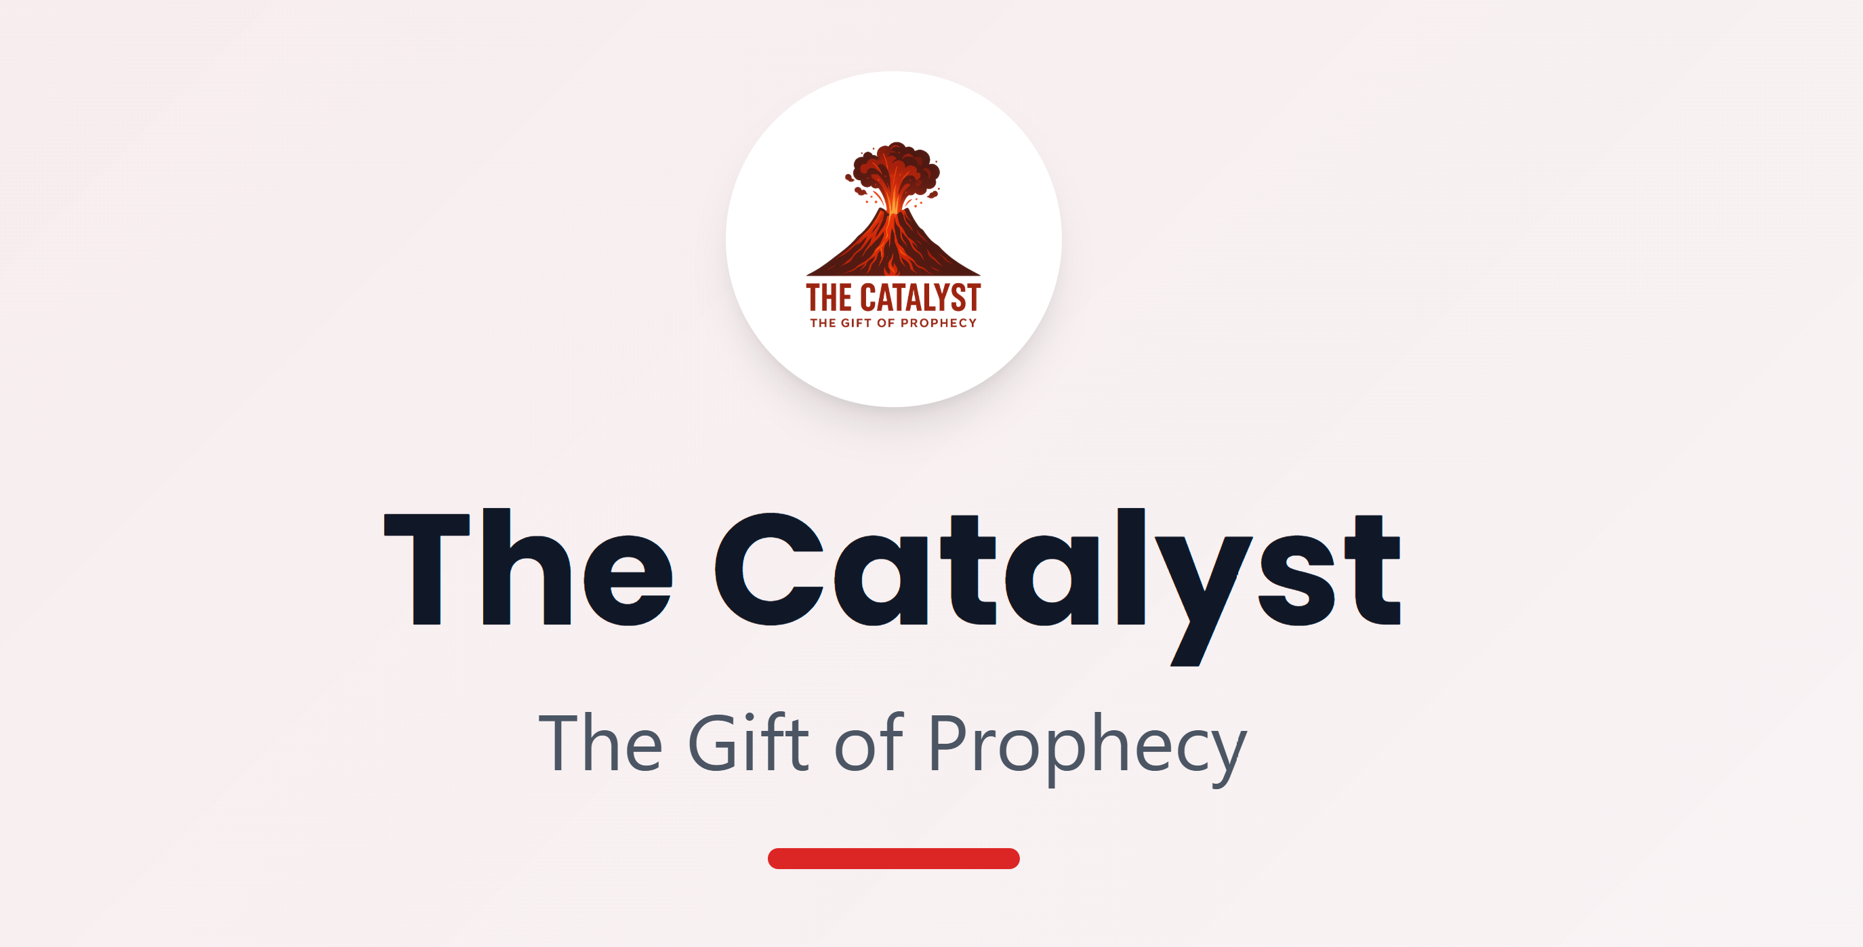

Slide 20


Slide 21

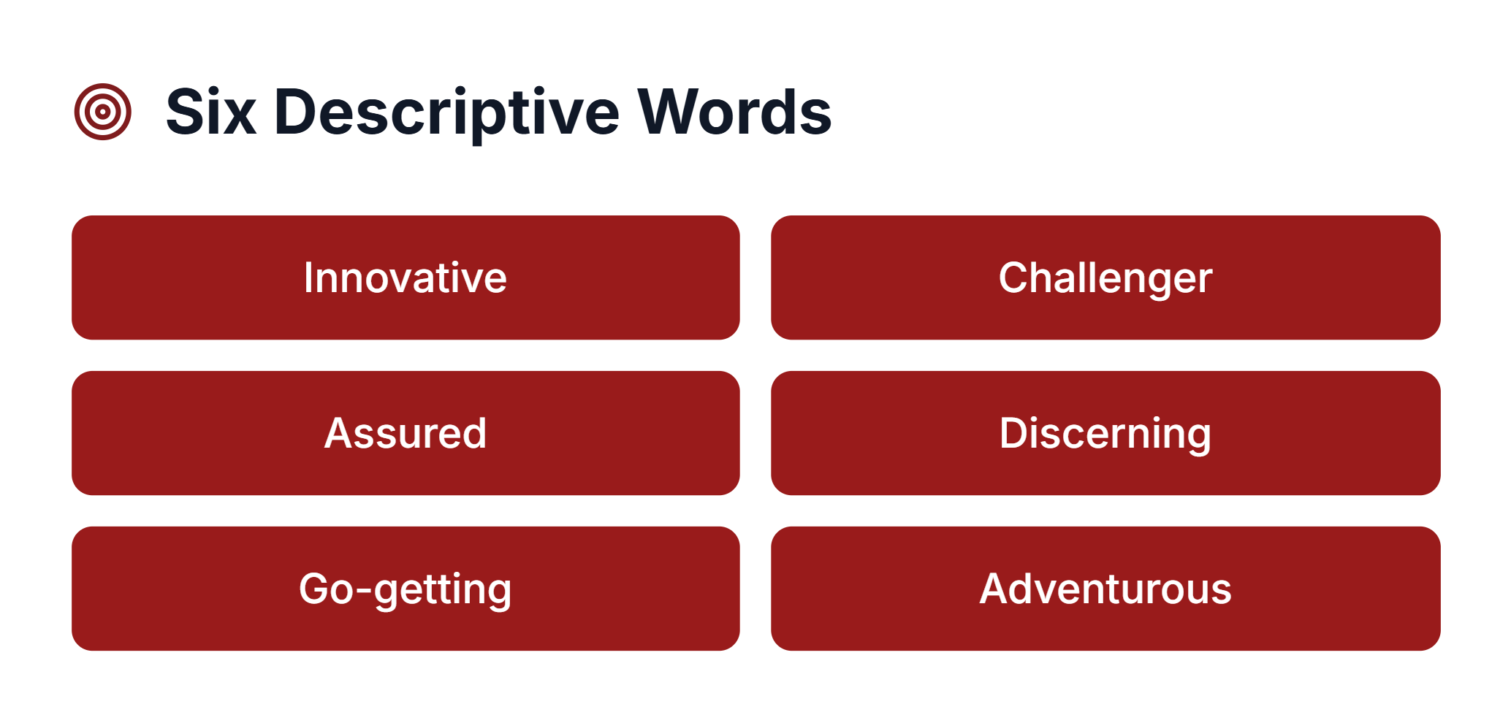

Slide 22
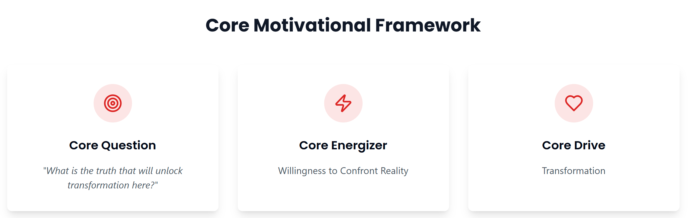

Slide 23
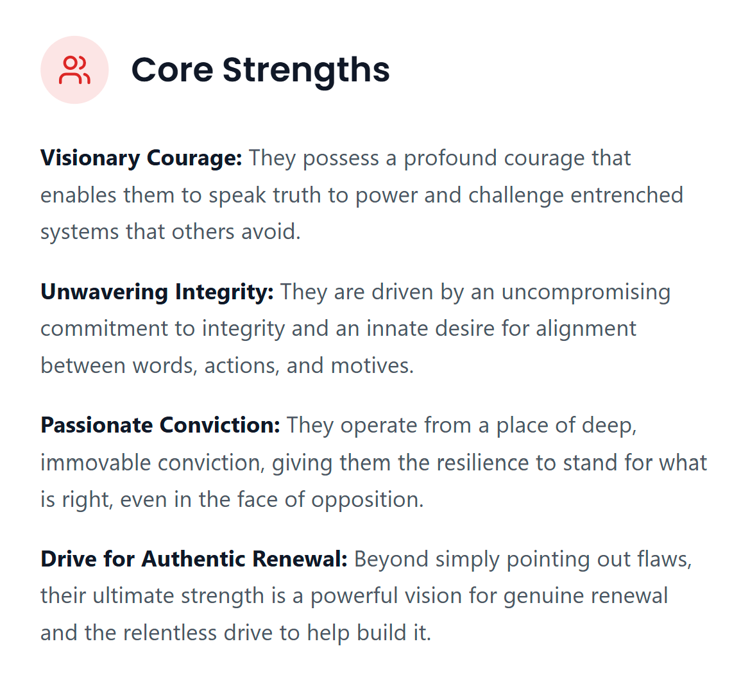

Slide 24
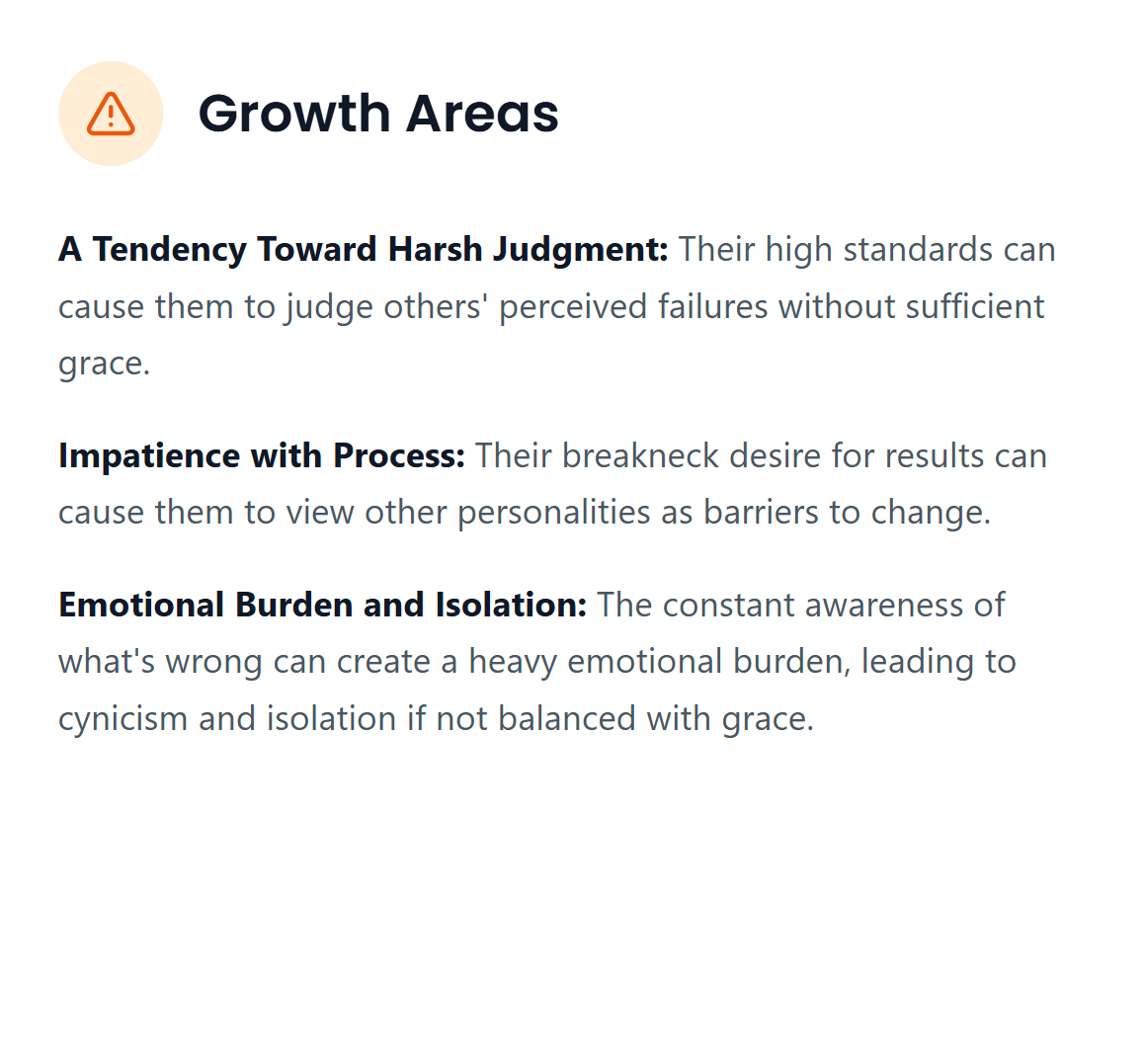

Slide 25
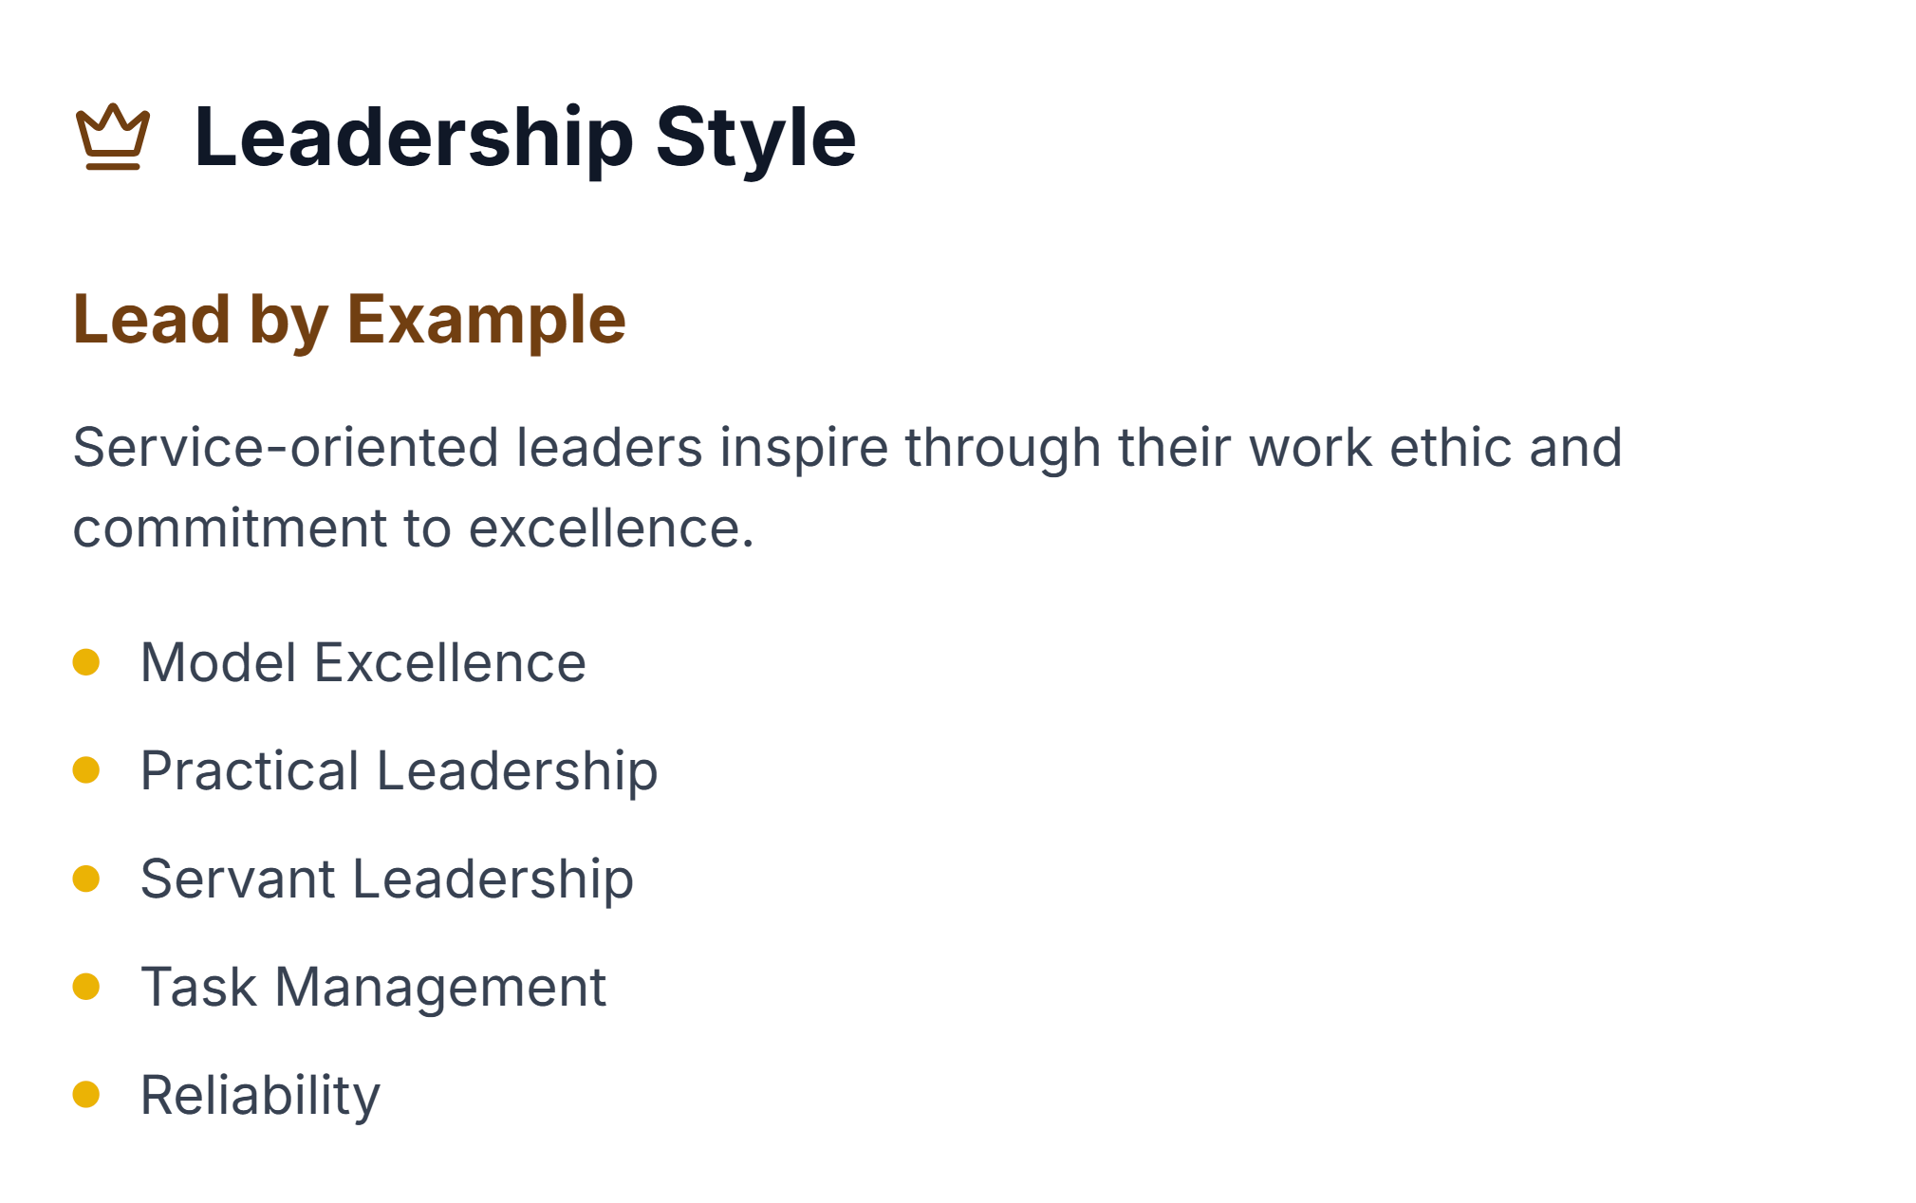

Slide 26
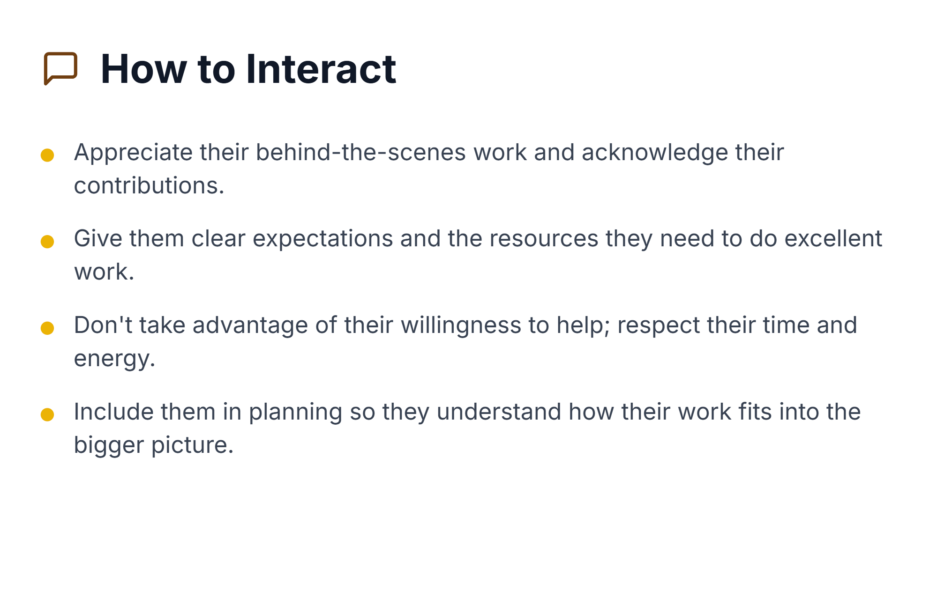

Slide 27
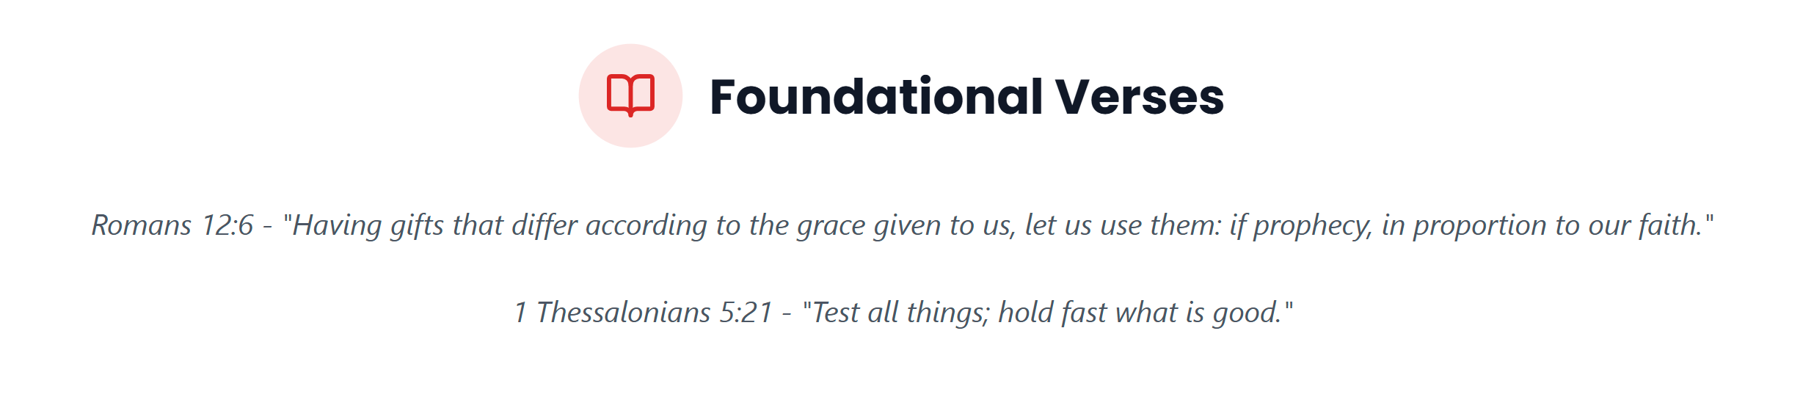

Slide 29


Slide 30


Slide 31

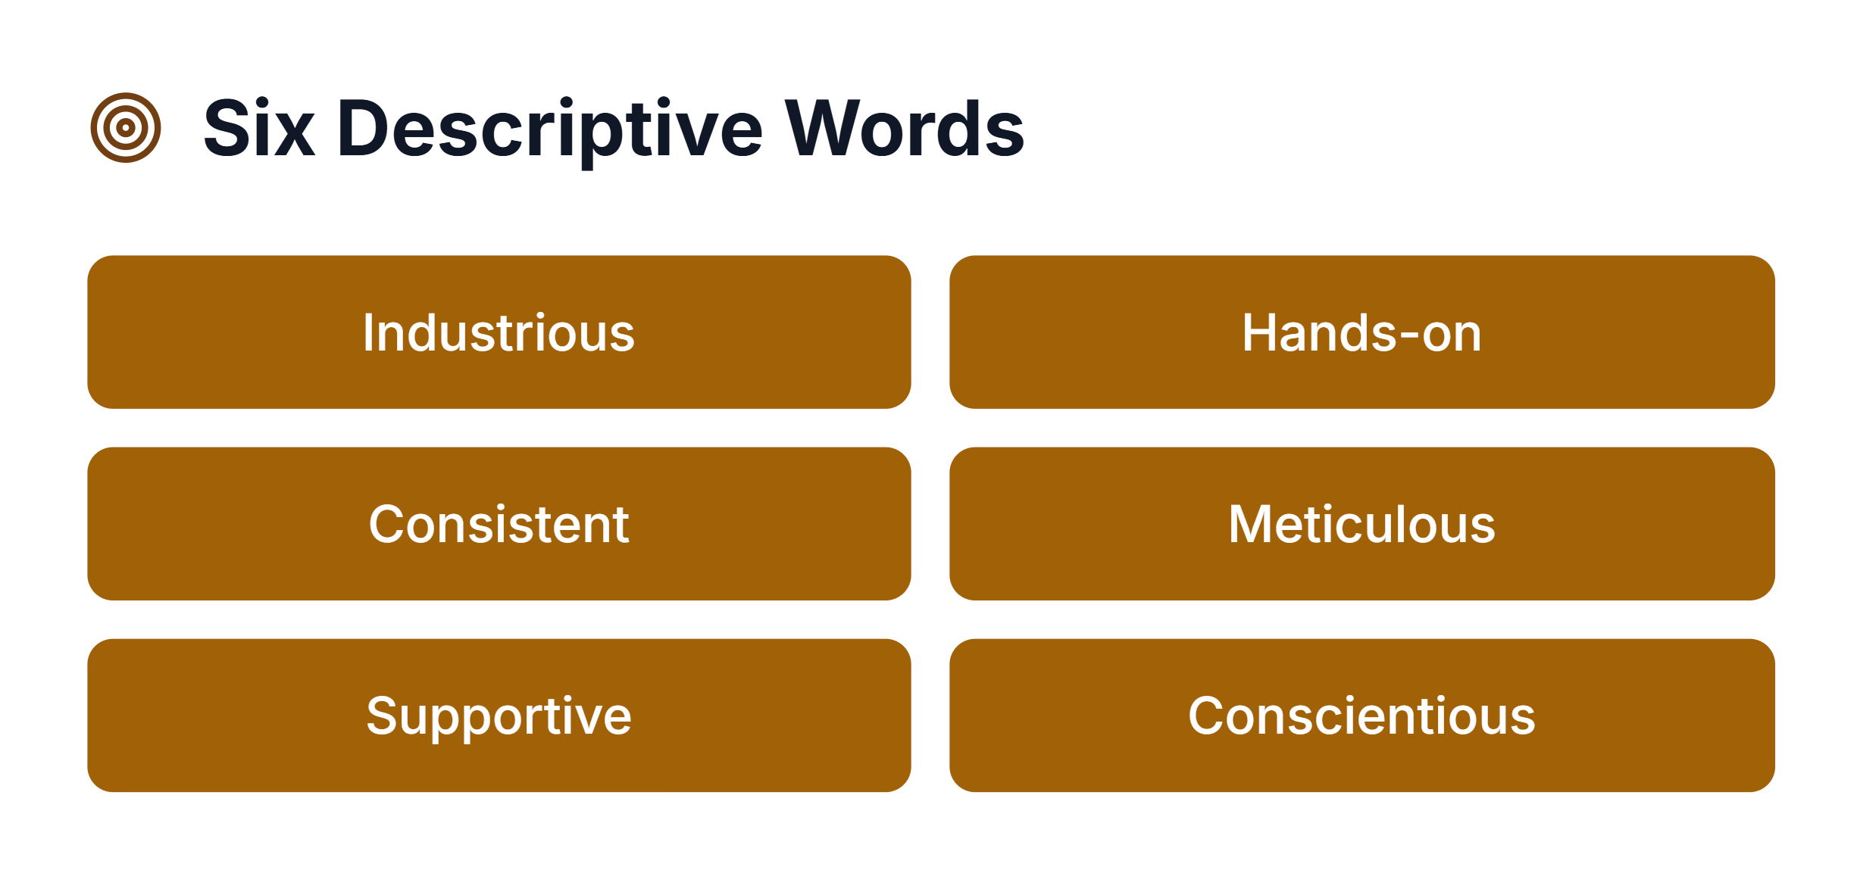

Slide 32
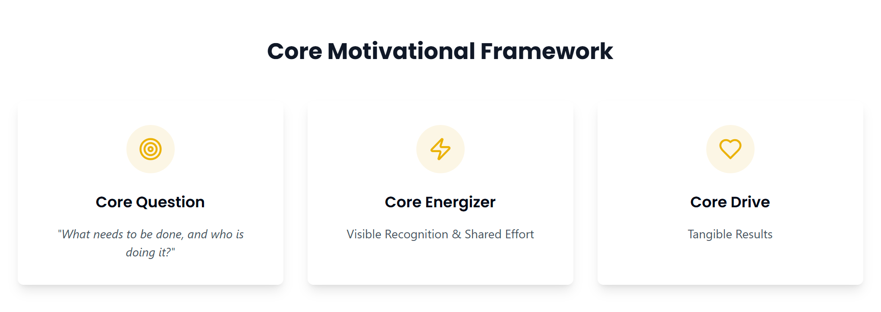

Slide 33
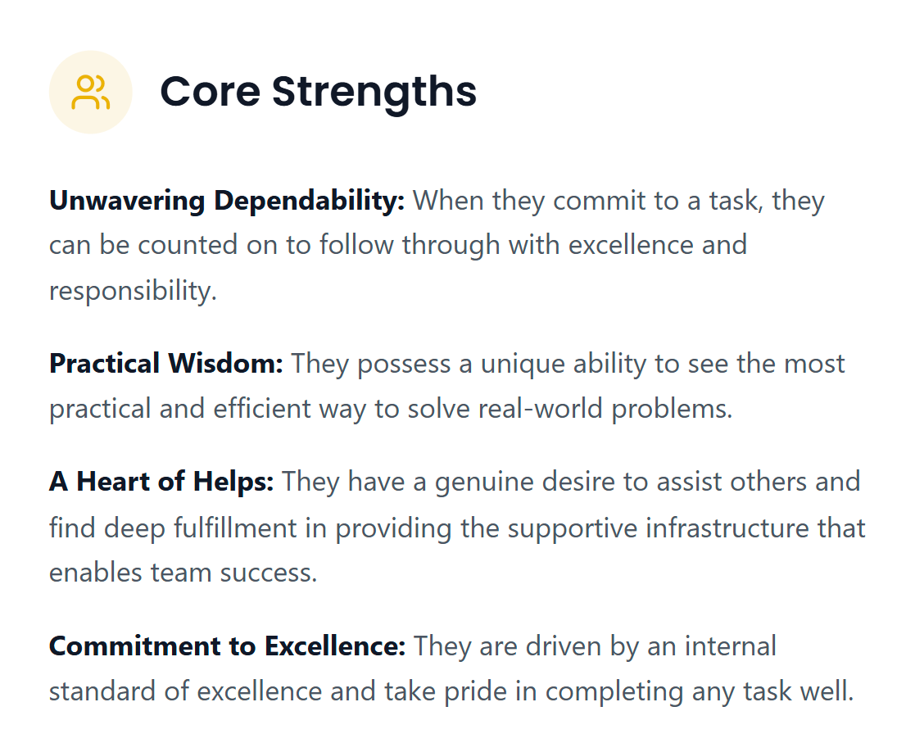

Slide 34
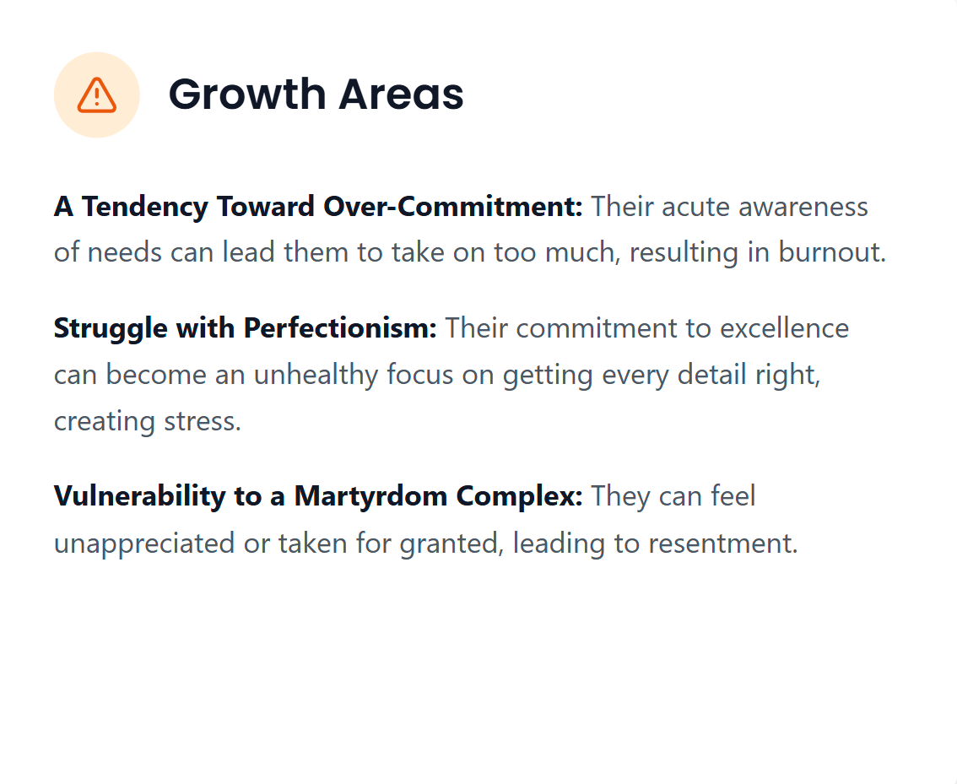

Slide 37
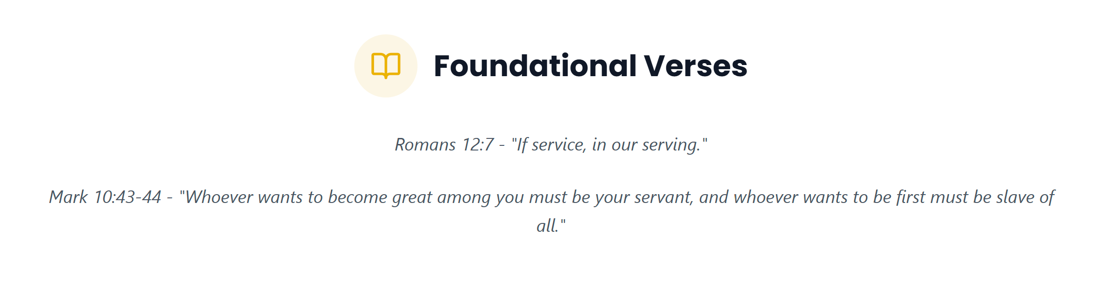

Slide 38
The Do, Think, Feel Framework was adapted from the 7 Life Languages https://www.lifelanguages.com/

Slide 39
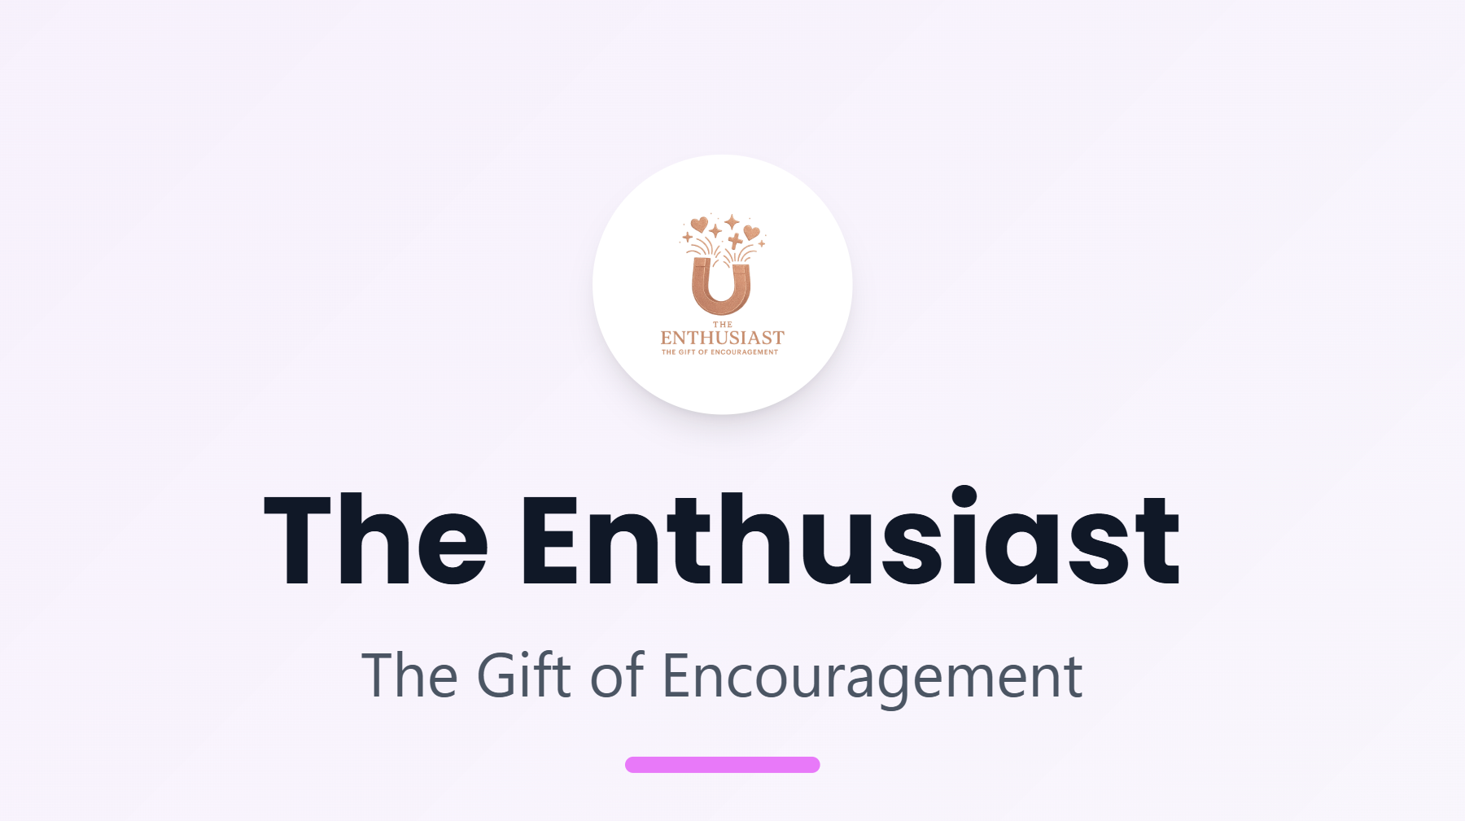

Slide 40


Slide 41

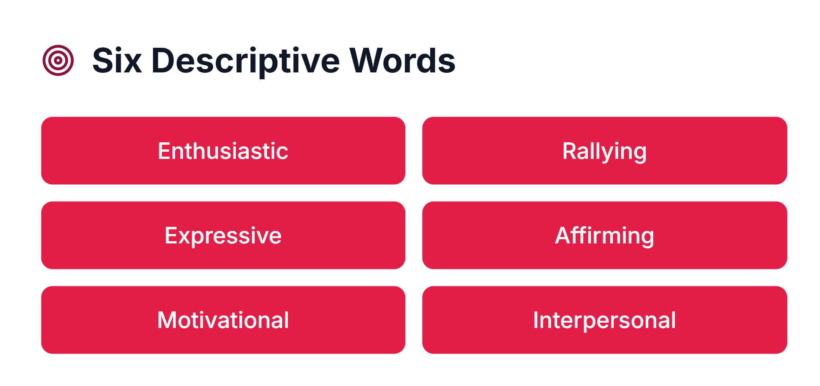

Slide 42
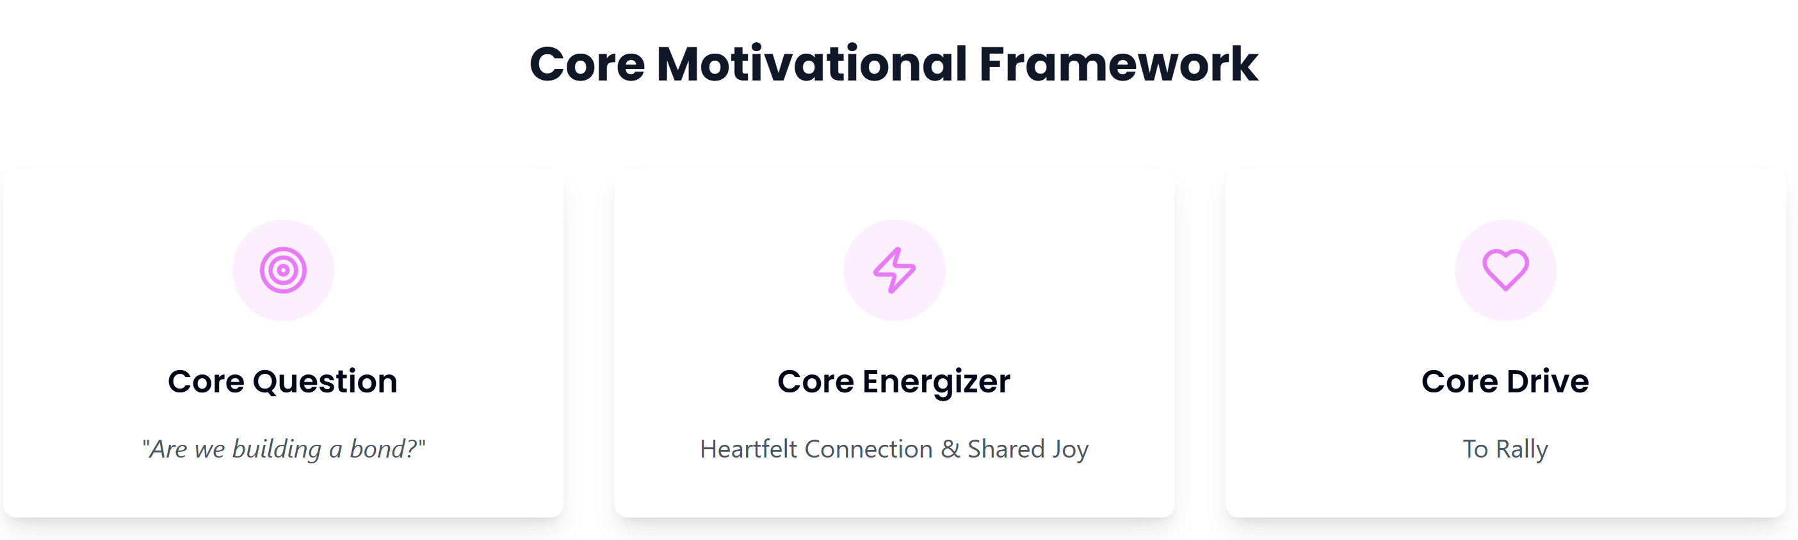

Slide 43
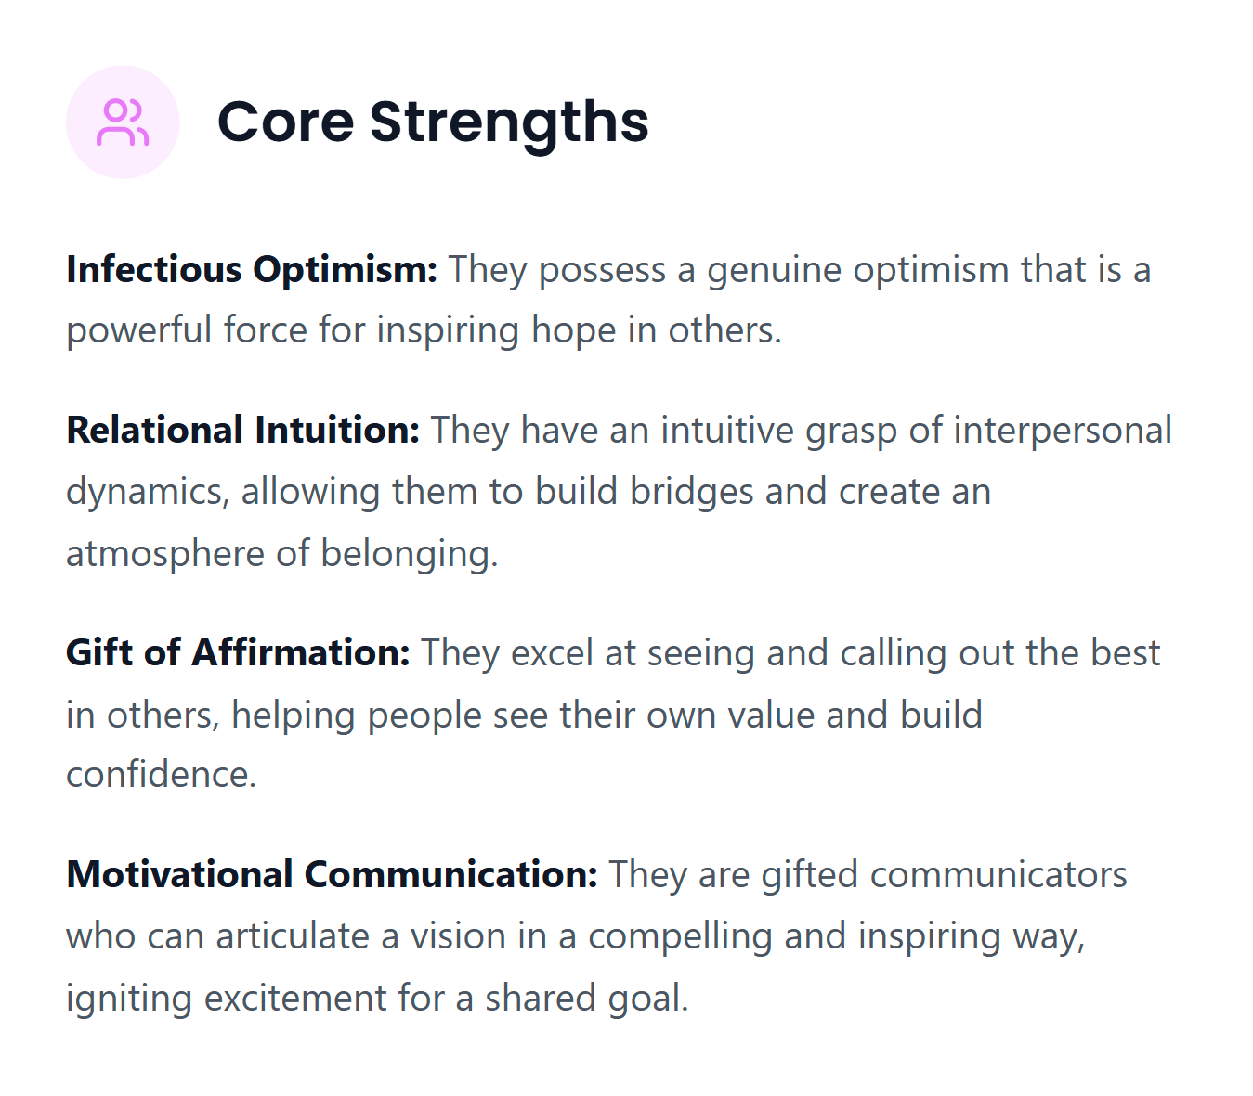

Slide 44
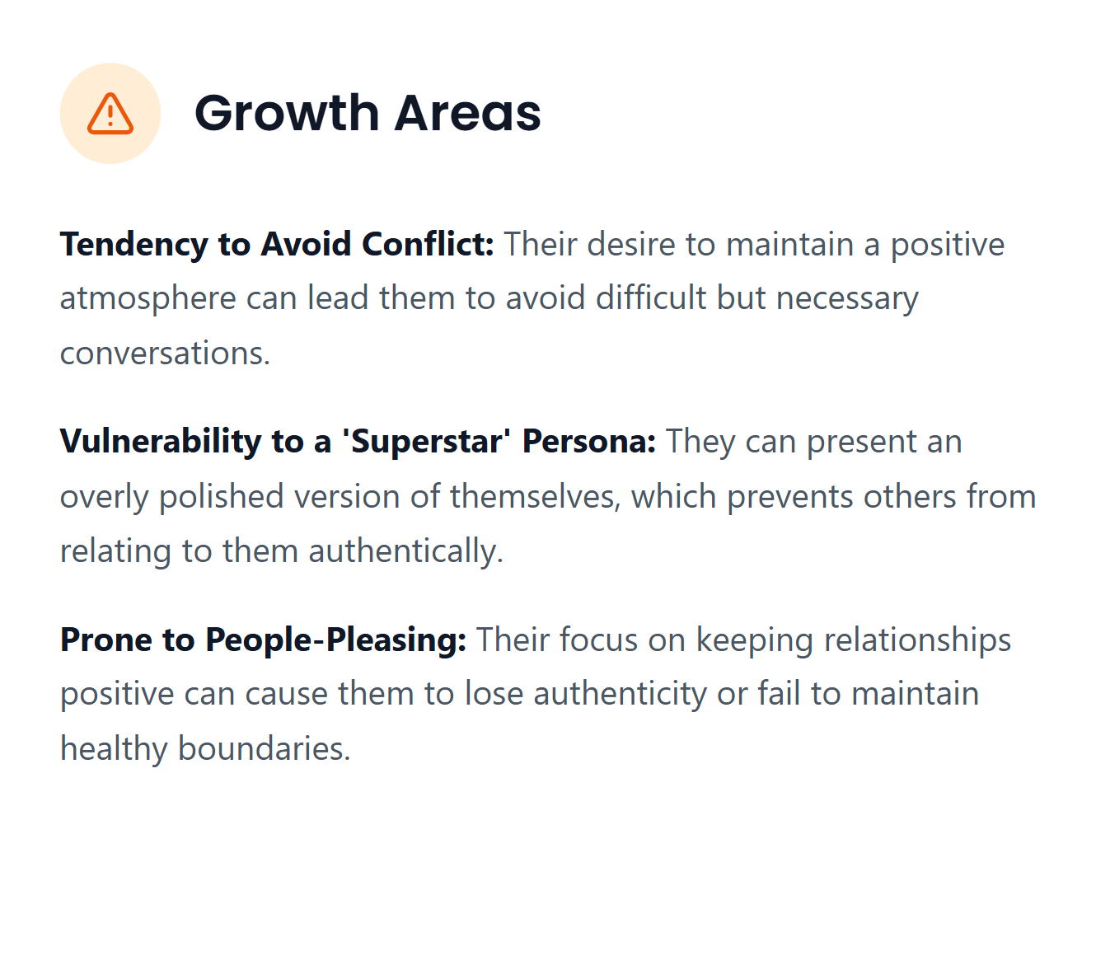

Slide 45
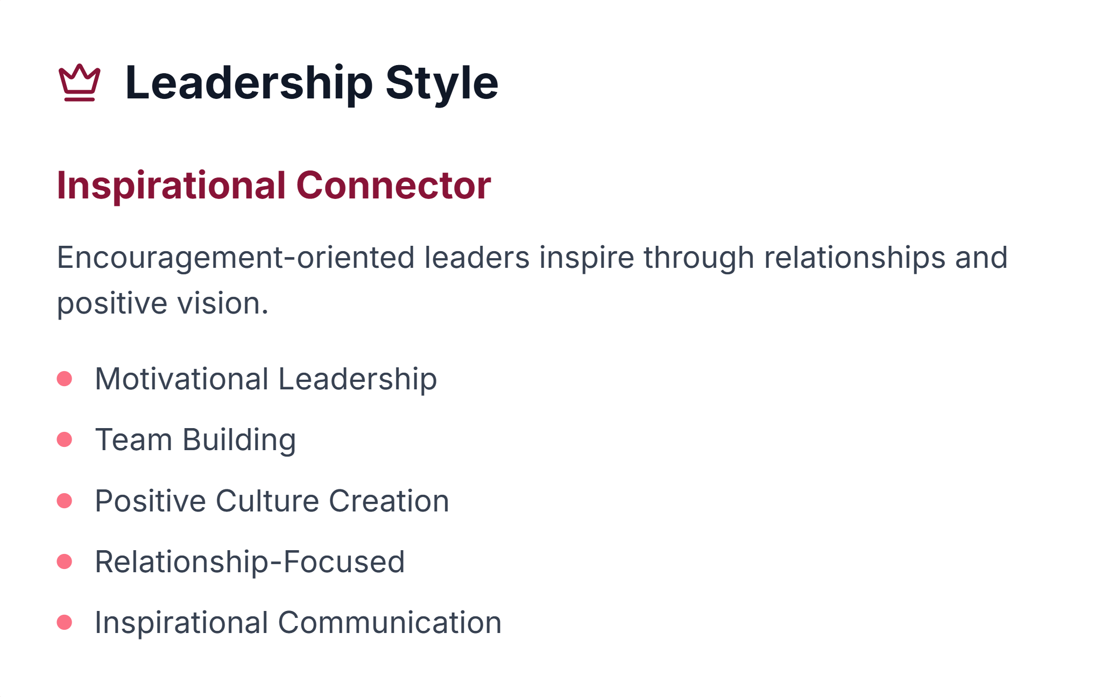

Slide 46
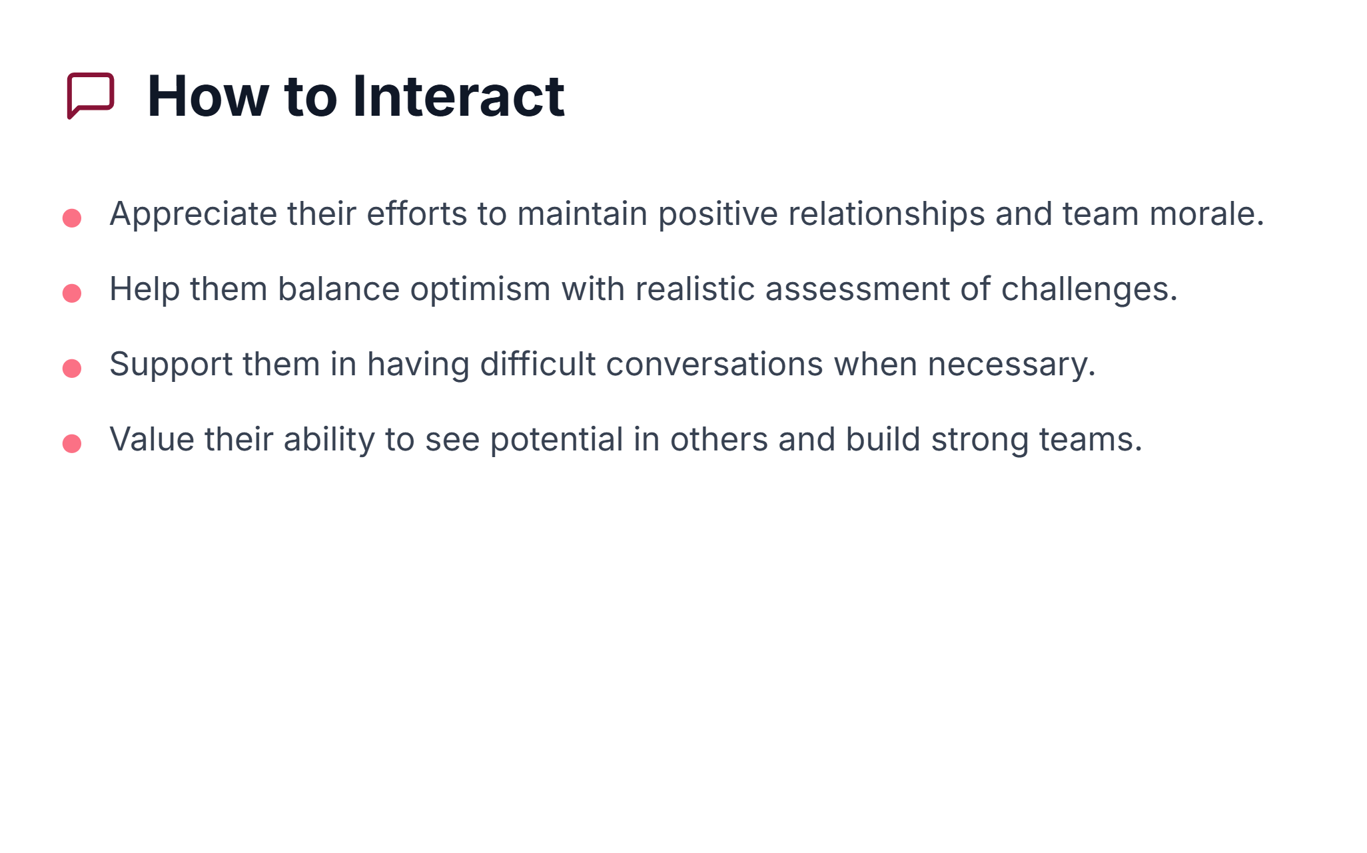

Slide 47
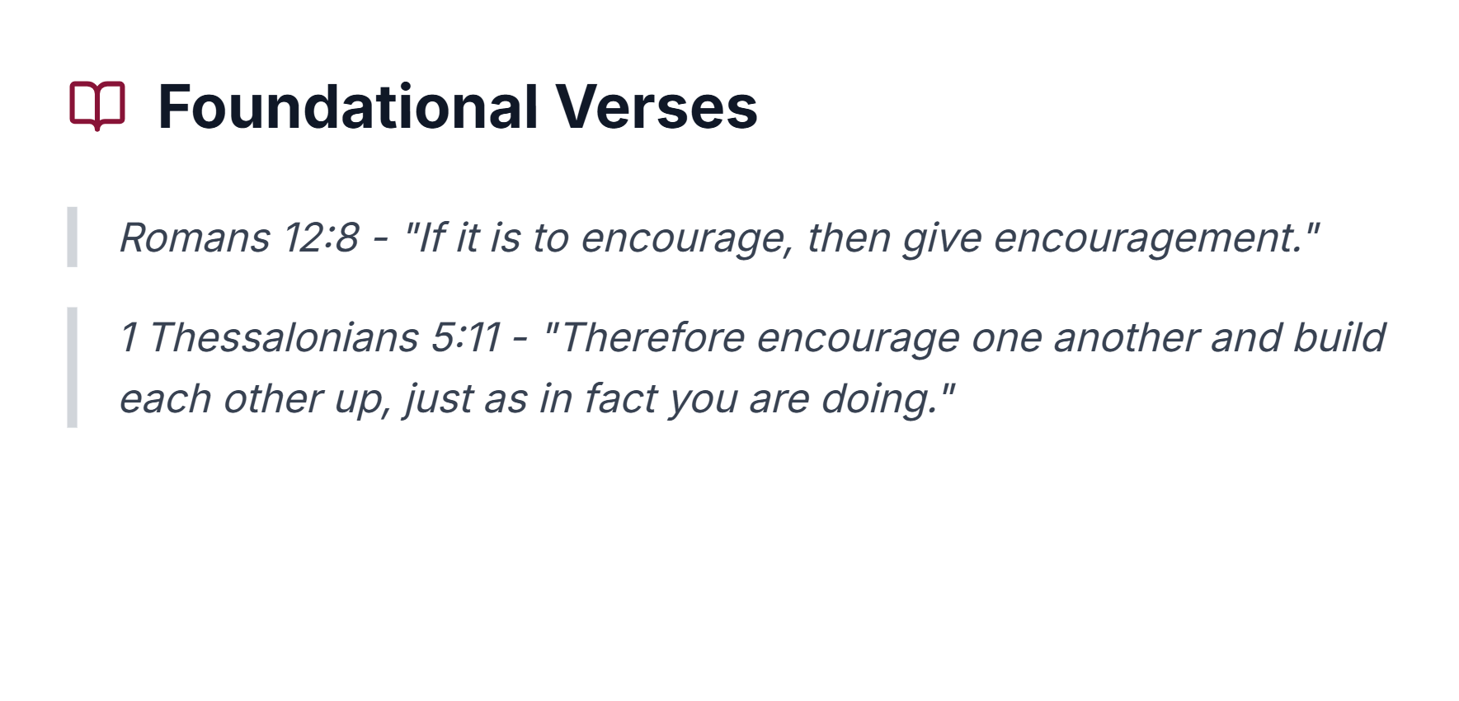

Slide 48
The Do, Think, Feel Framework was adapted from the 7 Life Languages https://www.lifelanguages.com/

Slide 49
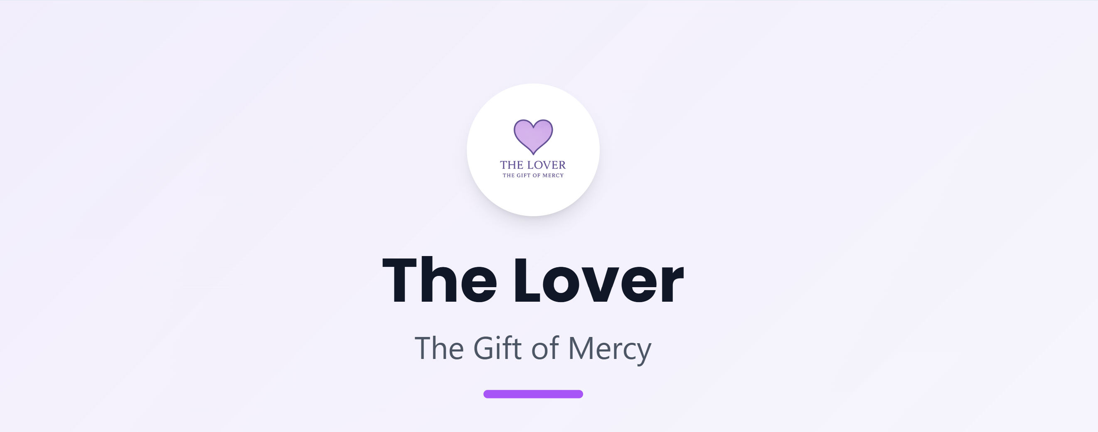

Slide 50
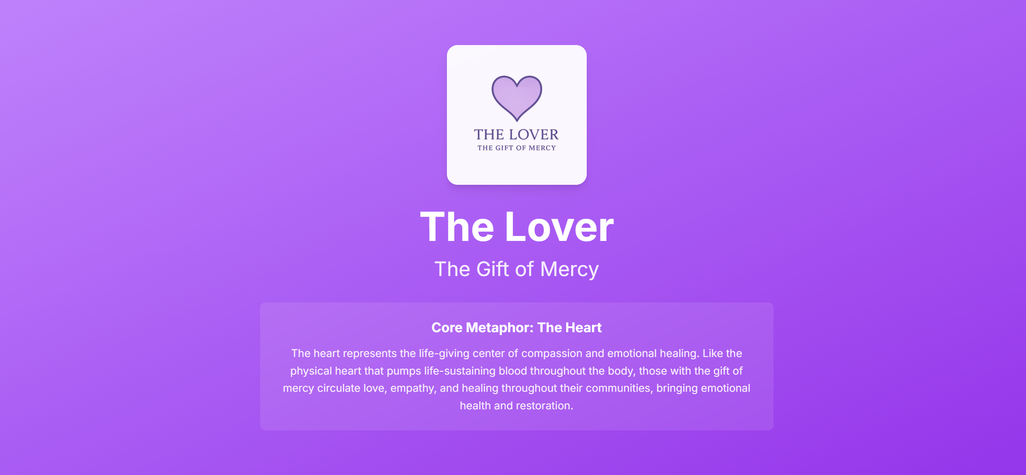

Slide 51

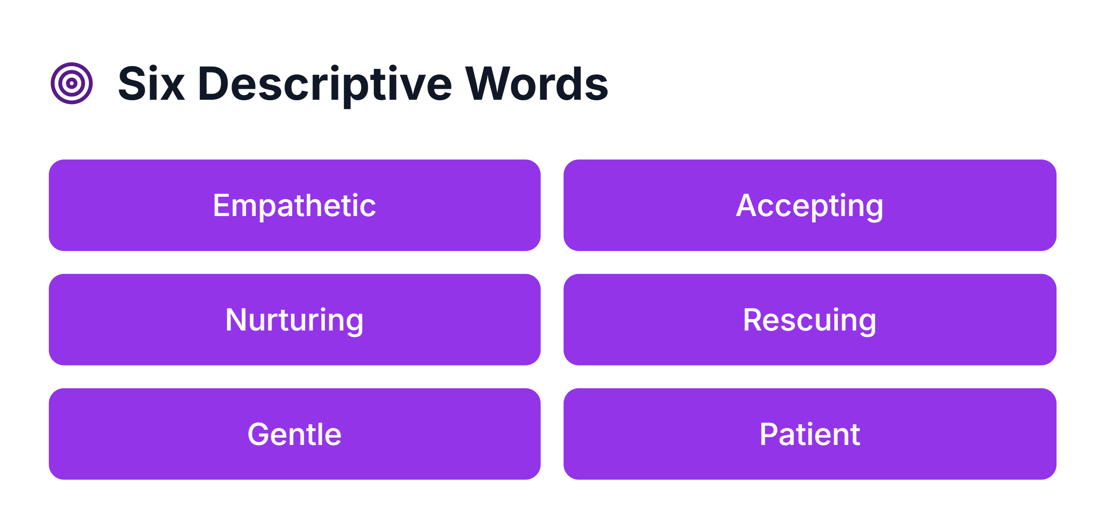

Slide 52
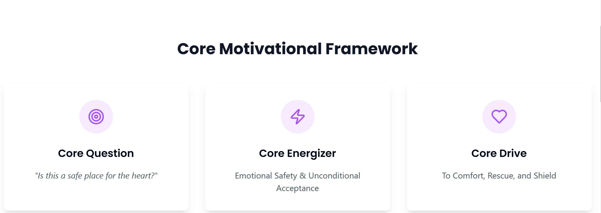

Slide 53
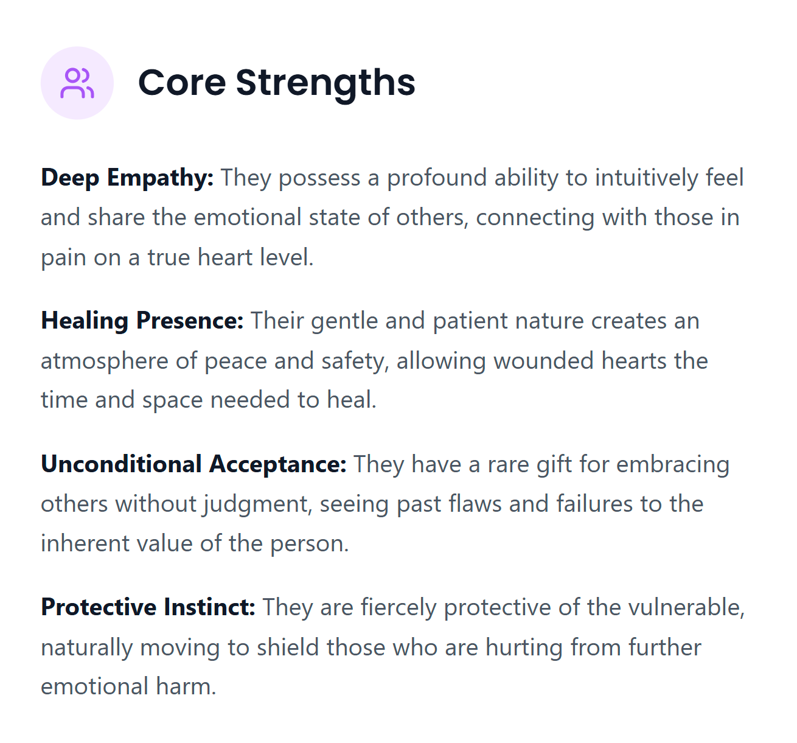

Slide 54
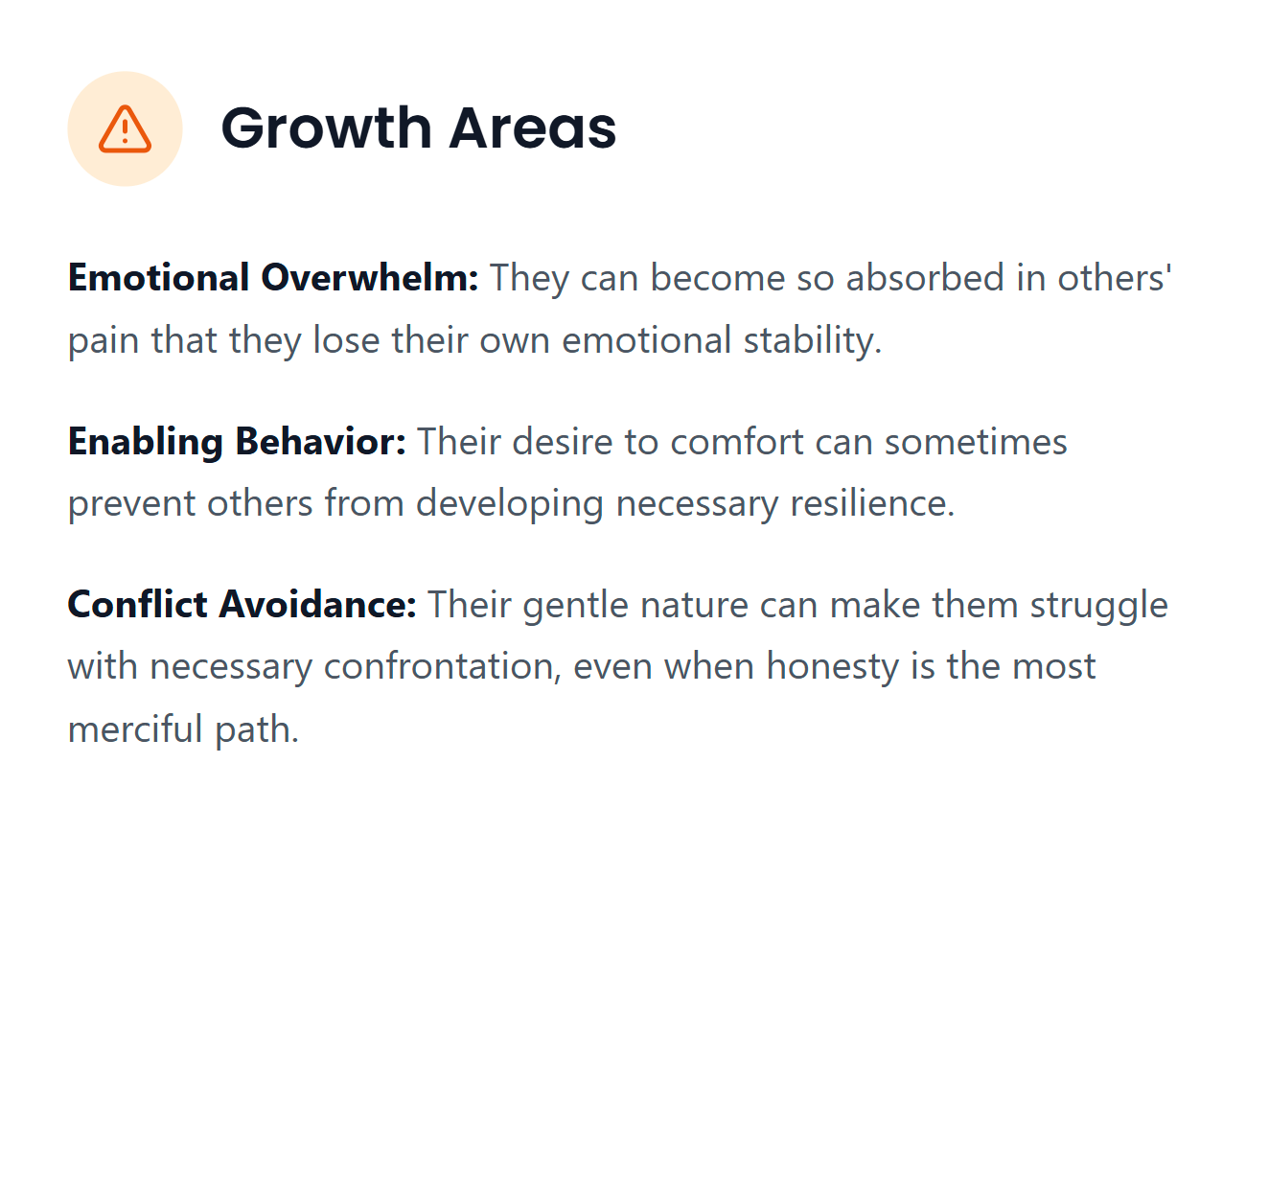

Slide 55
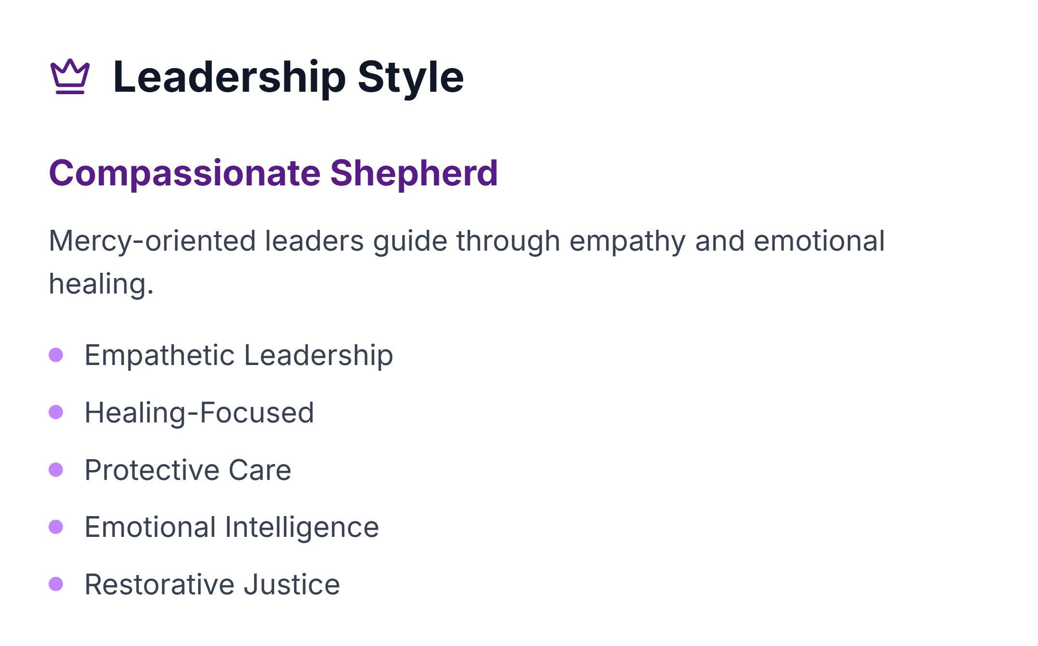

Slide 56
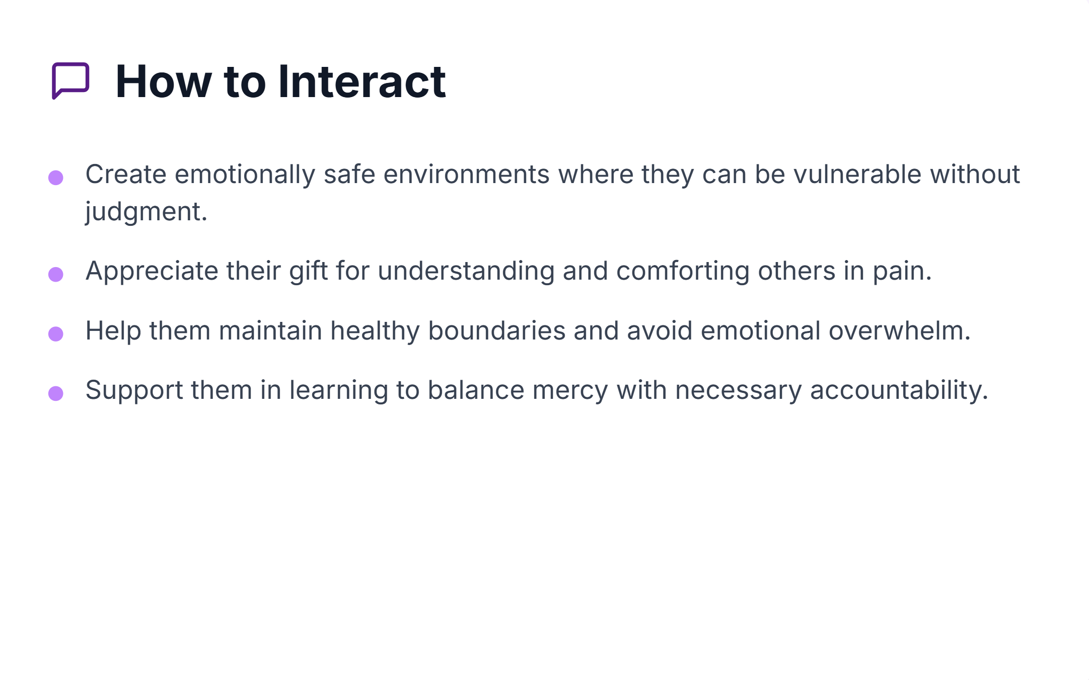

Slide 57
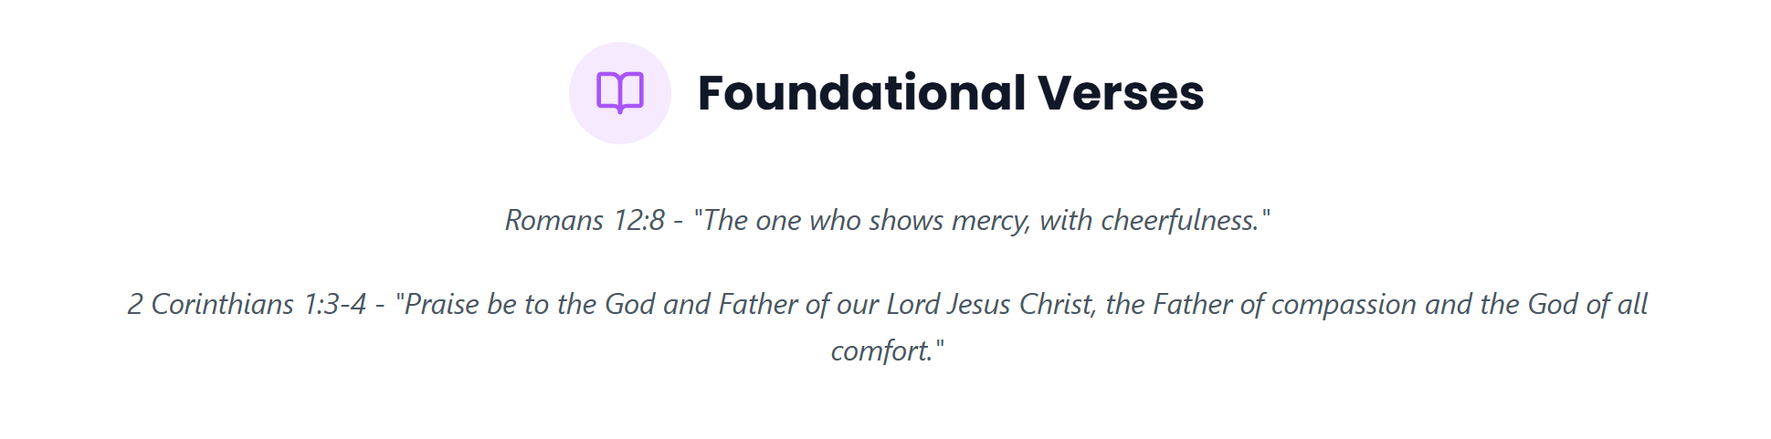

Slide 58
The Do, Think, Feel Framework was adapted from the 7 Life Languages https://www.lifelanguages.com/

Slide 59


Slide 60


Slide 61

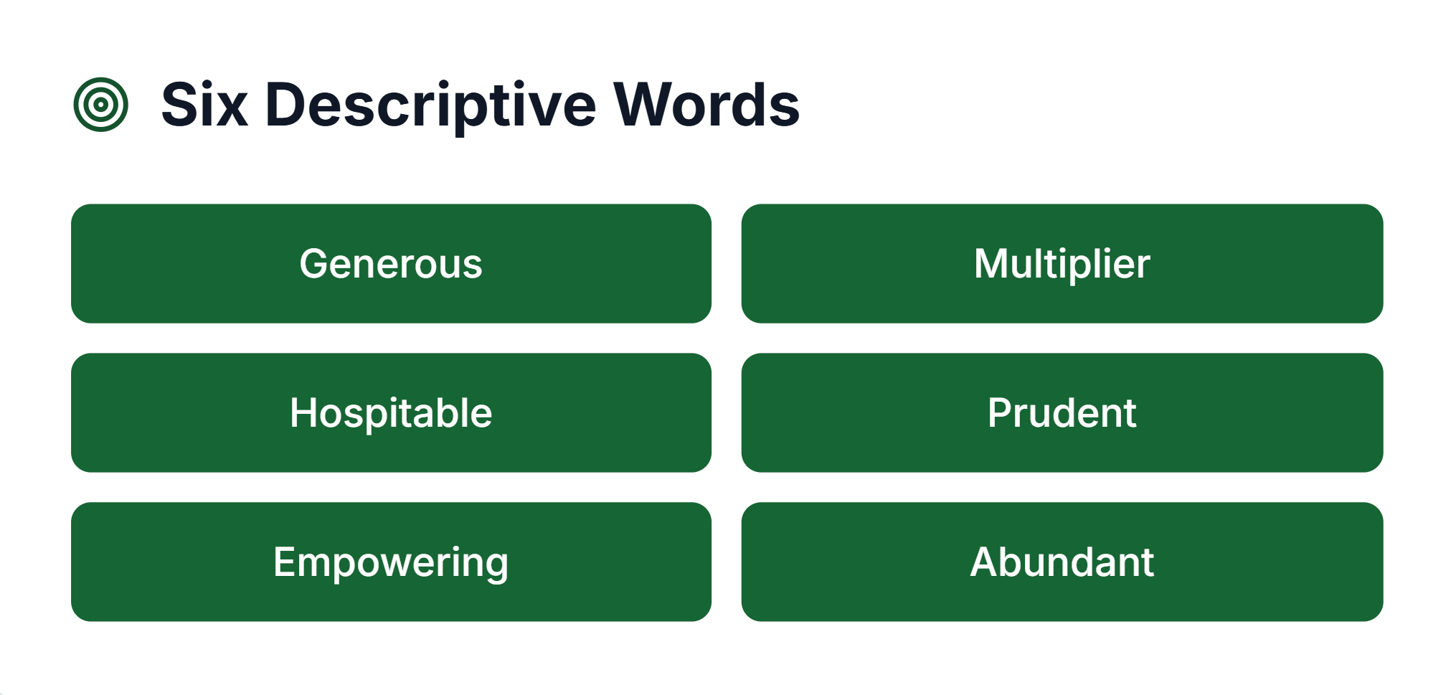

Slide 62
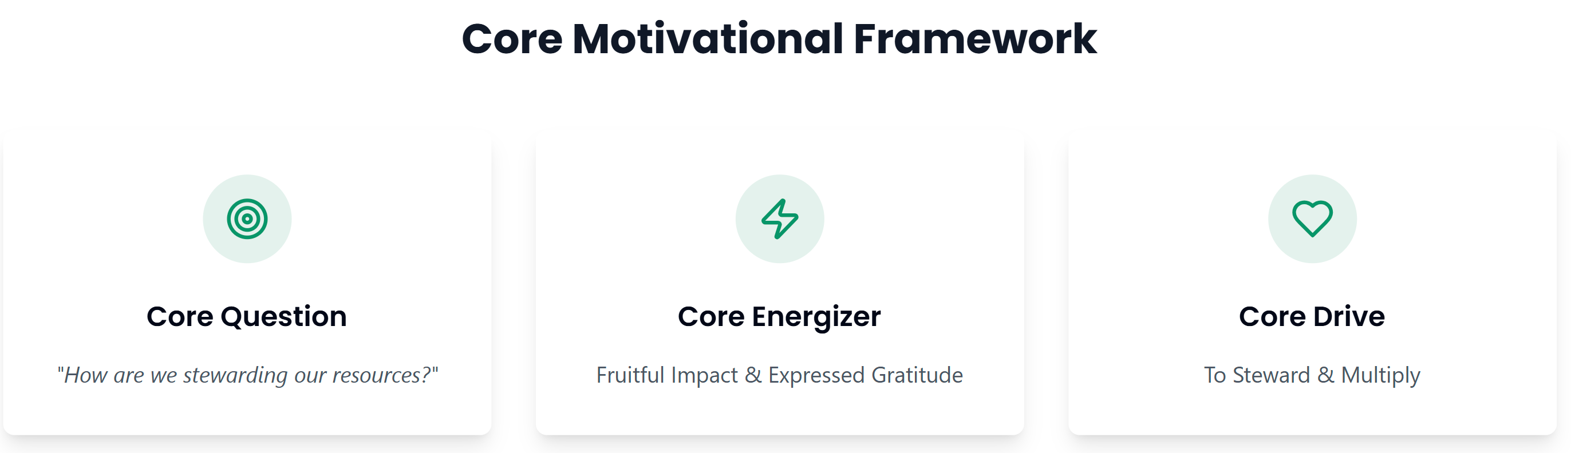

Slide 63
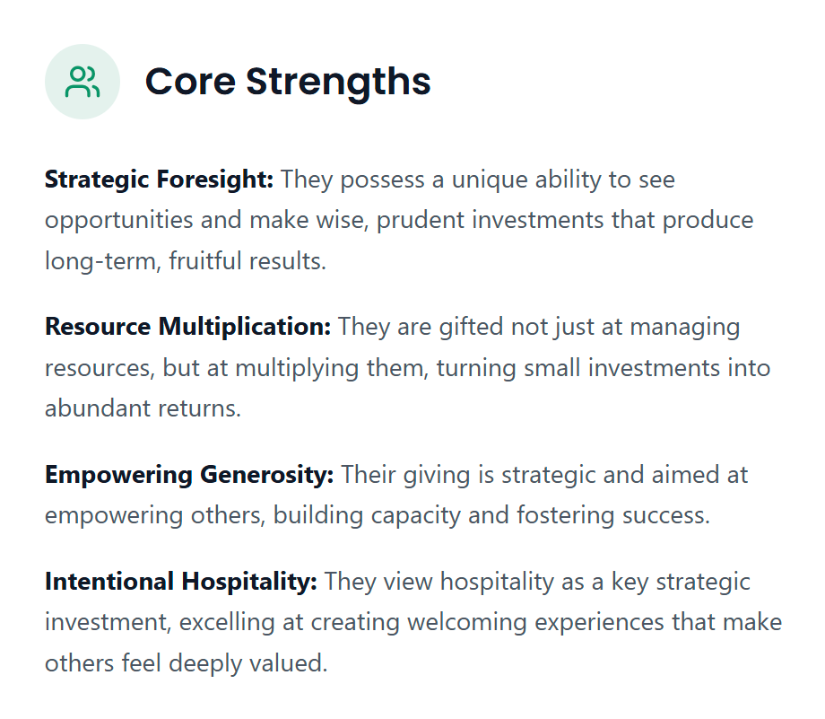

Slide 64
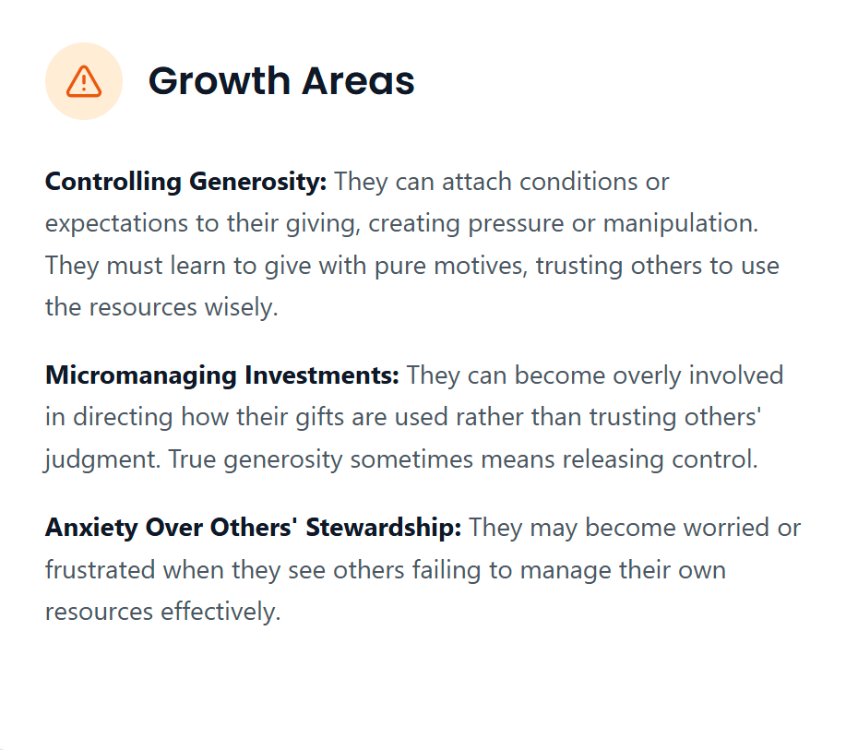

Slide 65
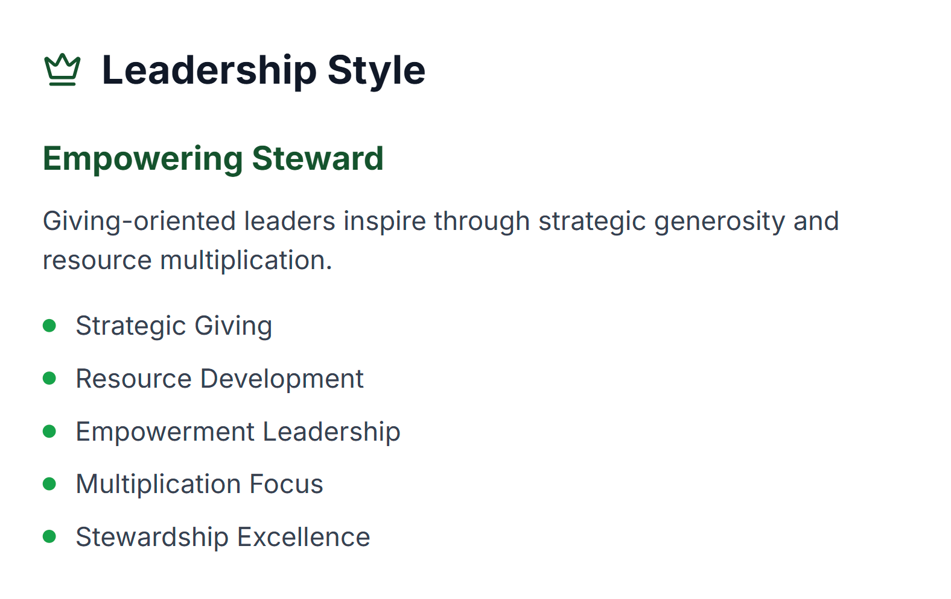

Slide 66
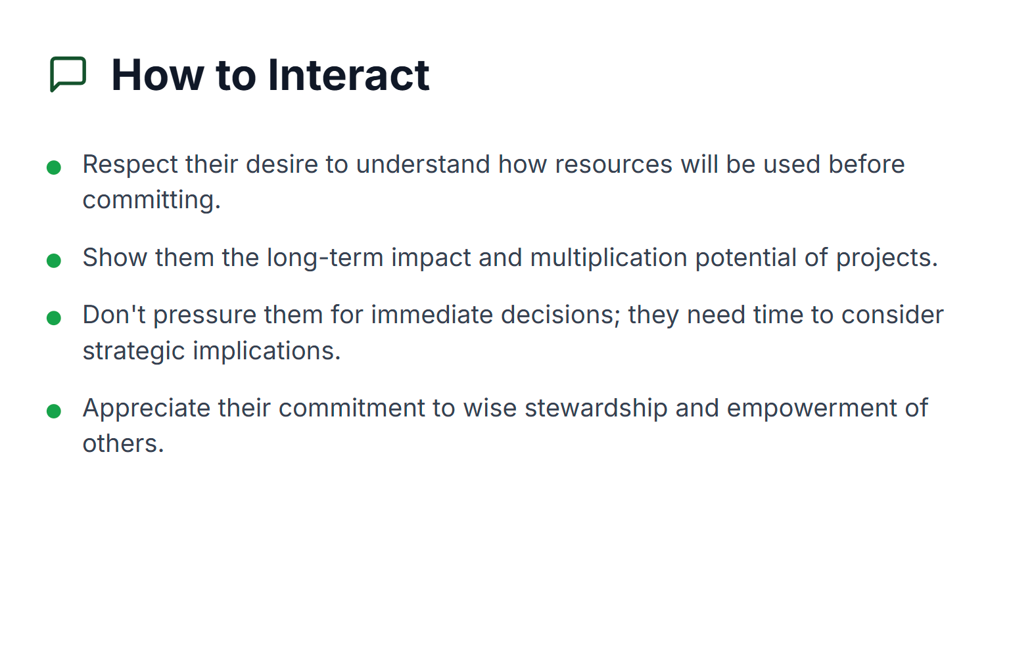

Slide 67
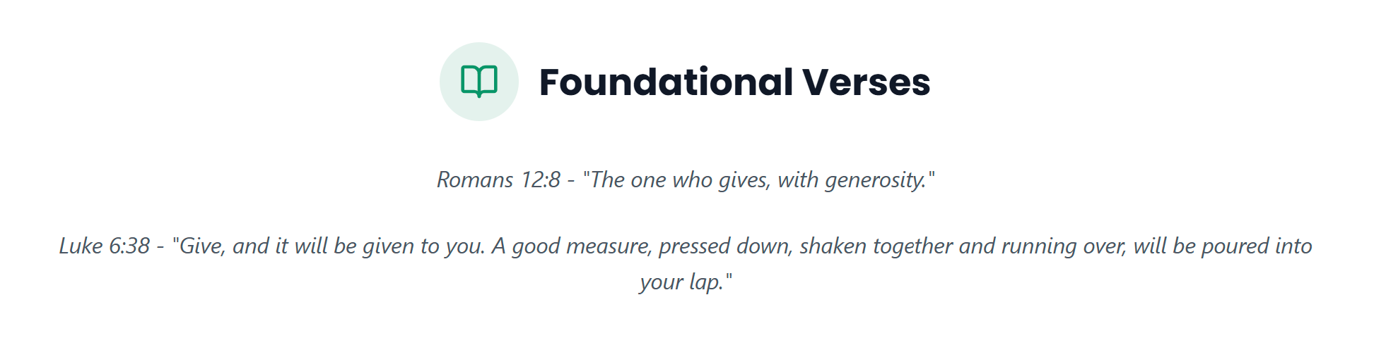

Slide 68
The Do, Think, Feel Framework was adapted from the 7 Life Languages https://www.lifelanguages.com/

Slide 69


Slide 70


Slide 71



Slide 72


Slide 73


Slide 74


Slide 75


Slide 76


Slide 77


Slide 78
The Do, Think, Feel Framework was adapted from the 7 Life Languages https://www.lifelanguages.com/

Slide 79


Slide 80


Slide 81



Slide 82


Slide 83


Slide 84


Slide 85


Slide 86


Slide 87


Slide 88

What is available for Bishop Students?
As a personal counselor, I am available to meet with you to help you process difficult to process life circumstances.
Feel free to come to my office, or to email me if you desire to meet with me one on one.
Mr. Eggman: AEggman@bishopdiego.org.
•
•
•
•

Slide 89
Questions?

